Slide 1
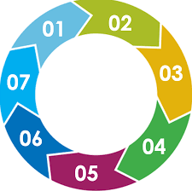
Abusive Head Trauma in Babies
[Abusive Head Trauma in Babies] 7 MINUTE BRIEFING - To be shared at Team Meetings
Abusive Head Trauma (AHT) -also known as Shaken Baby Syndrome- is child abuse. It results in catastrophic injuries or death. Around half of severely injured survivors die before they reach 21 years of age.
In the UK, 200 children are injured or killed each year however it is likely the figures are much higher as AHT may not be considered as the cause of injury/death.
Fathers/male surrogates represent the majority of perpetrators
The human and financial cost is significant – yet AHT is AVOIDABLE
Start
Following a local CSPR Herts and Essex have joined the national roll out of the ICON programme to support parents and caregivers and prevent AHT. For more information, please speak to your safeguarding lead or ICON project lead Lucy.Sims4@nhs.net
Research suggests that some people lose control when a baby’s crying becomes too much, and that simple messaging can be effective to support parents and care givers to cope with infant crying.
It is important that we recognise that all parents and carers of babies appreciate some advice about how to comfort a crying baby.
ICON is a programme that promotes and provides simple messaging and resources to all parents and carers of babies from pregnancy onwards –.
everybody has a role to play in preventing AHT
Website: Home - ICON Cope
Coping with crying can feel like living on a cliff edge and caregivers can lose control and shake,. This occurs in every socio-economic group.
CRYING. There is a demonstrable relationship between normal peaks of crying and AHT. Research shows babies are most likely to be shaken between 2-4 months at exactly the time when babies normally cry the most

