Slide 1
Families First News sharing Keeping in Touch KAREN DORNEY HEAD OF SERVICE SUPPORTING FAMILIES | CHILDRENS SERVICES
NOVEMBER 2024

Slide 2
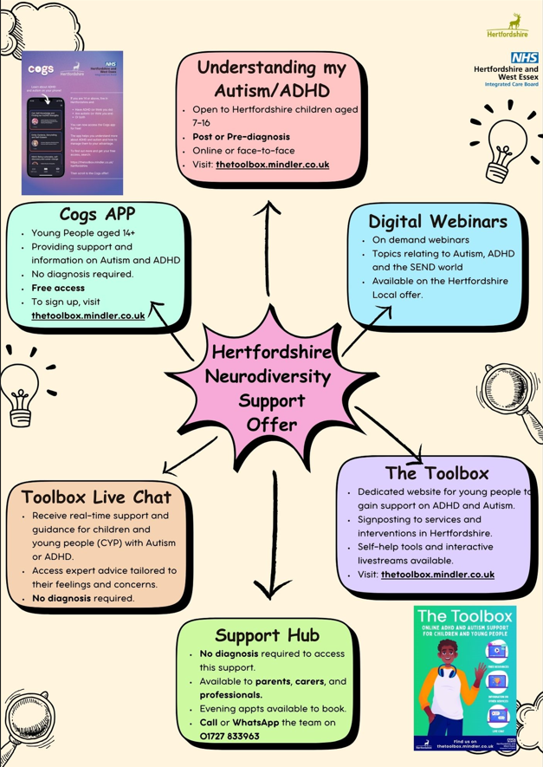
Hertfordshire Neurodiversity Support Offer
The HCC and ICB offer consists of various resources including group courses, webinars, and a live web chat for young people, as well as the support hub and digital webinars for parents/carers and professionals.
Useful links:
Neurodiversity Handbook - providing a wealth of resources, support, and signposting for parents and Neurodiversity Service Directory (hertfordshire.gov.uk) - for more support options.
Details of all these offers can also be found on the Neurodiversity Support (hertfordshire.gov.uk).

Slide 3
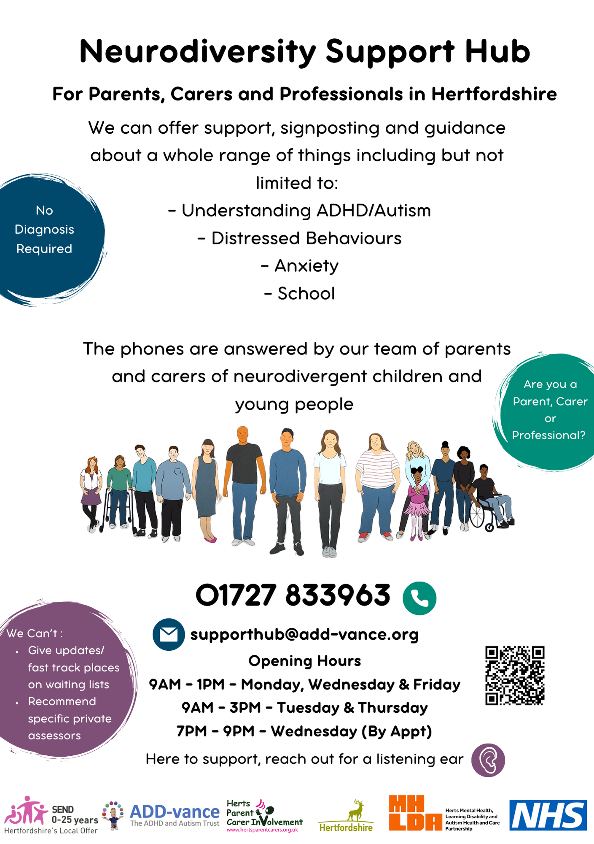
Extended hours at the Neurodiversity Support Hub
In addition to the current hours the hub will now be open two afternoons and one evening each week.
In school holidays the hours will revert back to the current hours of Monday to Friday 9AM - 1PM and will continue to remain closed on Bank Holidays.
Term time Opening Hours are:
Monday, Wednesday and Friday - 9AM - 1PM
Tuesday and Thursday - 9AM - 3PM
Wednesday Evening (by appt only) - 7PM - 9PM
More info: ADD-vance

Slide 4
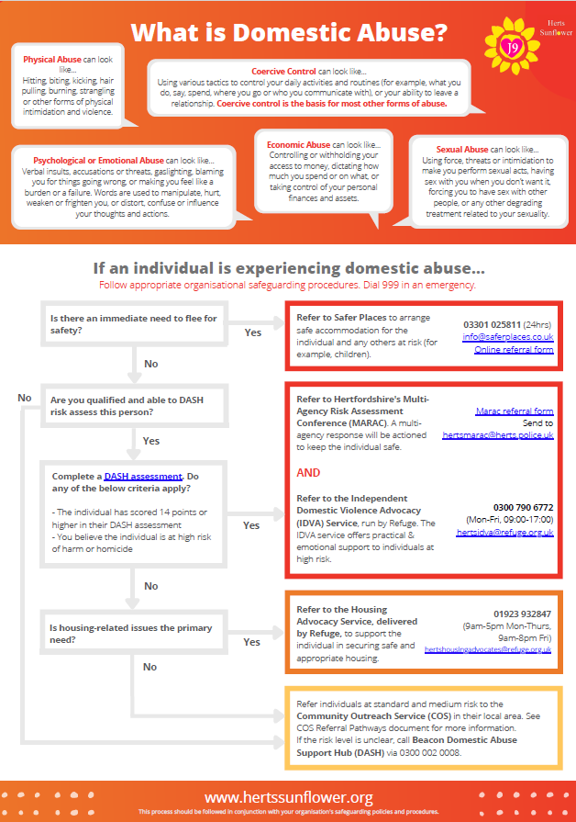
Herts Sunflower Pathways
2 Domestic Abuse Referral Pathway Posters : for reference and to promote/display
For Professionals:-
For Public:-
Notes:
TM to review

Slide 5
Sunflower News - October 2024
Useful information to download
Find out more about the REFUGE Hertfordshire Housing Advocacy Service : Download the information sheet
Beacon Domestic Abuse Support Hub : Download the Poster to display in public areas
Notes:
TM to review

Slide 6
16 Days of Activism: Partnership Comms & Events
We have 3 intersecting campaigns fast approaching:
16 Days of Activism Against Gender-Based Violence (25 Nov – 10 Dec)
White Ribbon Day (25 Nov)
Orange the World (25 Nov)
All of these campaigns focus on eradicating violence against women and girls.
If your organisation is planning any partnership- or public-facing communications/engagement activity or events during the 16 Days period, please let us know so we can celebrate and promote your initiatives on our Families First networks.
For further information on campaigns running, please email sunflower.news@hertfordshire.gov.uk.

Slide 7
Becoming Dad
Hertfordshire Family Centre Service are offering BECOMING DAD - Peer support workshop for expectant and new fathers
Meet other dads and learn from their experiences
Value the important role of becoming a father
Build confidence around hands-on baby care, bonding & attachment
Learn about healthy relationships
Maintain good mental health for yourself and your partner
More info download the leaflet here:

Slide 8
Male Inclusive Practice – Think Male Carers
We have created an infographic to keep the focus on male carers in mind and THINK male carers when completing all family work and assessments.
You can print this out and display in your buildings as well as sharing with teams and any other professionals you think may find it beneficial.
Engaging Fathers: Are you including dads and male carers in all your work? - Herts CC (hertfordshire.gov.uk)

Slide 9
NOW BOOKING FOR 2025 Supporting Links Parenting Support Groups
Starting in January and February, Supporting Links have 11 online courses as well as 1 face to face group in Dacorum.
Each course runs over 6 weekly sessions and is offered FREE of charge to parents.
Talking Additional Needs (2 online)
Talking Families (3 online courses)
Talking Teens (1 online course/ 1 Dacorum district course)
Talking Dads (3 online courses)
Talking Anxiety in Teens (1 online course)
Talking Anger in Families (1 online course)
Alongside their Parenting Courses, they are also offering the following 3 workshops this coming Spring Term. These are open to parents and carers of children with diagnosed or suspected ASD and/or ADHD across Hertfordshire, funded by the Local Authority.
Talking ASD/ADHD: Sibling Struggles - 13th February 2025
Talking ASD/ADHD: The Teenage Years - 4th March 2025
Talking ASD/ADHD: Responding to Anger - 2nd April 2025
They accept referrals or parents can self-refer via this link: Courses
Professional referrals can be made via email or phone to bookings@supportinglinks.co.uk 07512 709556.

Slide 10
First Steps ED : Free workshops for families
First Steps ED's four-week programme offering free online workshops for parents, carers & older siblings, who are supporting a young person with their body image, disordered eating and/or eating disorders in Hertfordshire.
It's called First Steps ED Skills for Carers. Sessions are delivered online (via Zoom) and following the first session, the team will close the group to ensure that the parents and carers in attendance can develop a positive peer group through the entire four-week programme.
To find out if workshops are available in your area and/or how you can get involved in upcoming workshops here: Skills for Carers - First Steps ED

Slide 11
BeeZee Families – Healthy After School Snack Ideas!
Beezee Families are offering FREE heathy lifestyles programmes to hundreds of families across Hertfordshire.
If you would like to sign up to Parent Mail, they will share with you twice a term to tackle the biggest challenges in making healthy choices.
Please share the attachment with parents via email / regular newsletters and on social media.
For more information:-

Slide 12
Referrals for HENRY – open again 0-5s parenting programme
The Henry parenting programme is now in a position to accept referrals again, with a view to offering families to join the Waiting List for our January-start of programmes until dates, times and venues are confirmed.
Please send in your referrals now, via links below they are gratefully received.
HENRY - Professional Page
Refer a Client to BeeZee Bodies
The Henry Programme provides support in:
Breastfeeding
Parenting skills
Emotional wellbeing
Eating patterns and behaviours – i.e. how we eat, not what
Healthy eating
Physical activity

Slide 13
Mental health awareness campaigns - Anti-bullying Week 11-17 November #ChooseRespect
Bullying in any form is unacceptable and always needs to be called out and stopped. There is information and signposting to support for tackling bullying at Just Talk Herts.
Whether it’s online or face to face, #bullying is NEVER acceptable. We all need to call it out, whether we’re the victim or a witness. Find info & support @JustTalkHerts: https://buff.ly/40u54jW #AntiBullyingWeek #ChooseRespect

Slide 14
Sandbox livestream event 26 November: Boys' Mental Health
The Sandbox are hosting a livestream event on 26 November at 5pm, talking about boys' mental health.
Young people can submit questions to be answered by a therapist during the livestream here.
Hertfordshire's Just Talk Week is also happening in November.
Hertfordshire’s children and young people’s mental health services (CYPMHS) system will be posting messages about these campaigns, events and services via @JustTalkHerts next month (November), so please remember to help spread the word, by liking and sharing the posts via your organisation's social media channels too, using the links below:
Facebook
Instagram
twitter/X

Slide 15
Launching Liberty Community Money Advice
We are delighted to announce that Liberty Community Money Advice will be launching on 4th October 2024! This free service will be based at the Liberty Tea Rooms on Thursdays and Fridays, and replaces our previous CAP Debt Help service.
Join Us!
To celebrate the launch of the new service we will be hosting a breakfast at the Liberty Tea Rooms 8.30-9.30am on Friday 4th October. We would love for you to be there

Slide 16
Focused Fortnight - Lite Bite Session on dental hygiene and headlice (4th Nov-22nd Nov 24)
IFST will be focusing on individual aspects of neglect in direct work with families with a different theme every 12 weeks including dental health and health eating.
Lite bite session took place (presentations below)
Alice Peacham and Juliette Williams from school nursing presented on nits and dental hygiene.
Packs have been put together ready for FIW to distribute over the fortnight.
For more information, please see below:-

Slide 17
Hertfordshire Young People’s Health and Wellbeing Survey 2024 is open until Friday 20 December!
The objectives of this survey are to:
Enable young people to share their views and feedback on a number of issues.
Provide secondary schools with useful data on their pupil population, including trend data over time.
Provide commissioners and a range of agencies with useful data on the Hertfordshire young person population, including trend data over time.
Enable effective commissioning and service delivery that meets the needs of Hertfordshire's young people.
The survey contains questions on a number of issues including:
Mental health and wellbeing
Drugs and alcohol
Healthy eating and physical activity
Relationships
Safety and bullying
To access the survey, follow the link below or use the QR code in the image,
www.hertshealthevidence.org/yphws

Slide 18
Key Families First Links
Keep up-to-date by reading o latest Families First: Families First News
Link to support for families:- Families First Website
Professionals area:-Early Help – information for professionals and partners
For Families First partnership groups, news sharing and general info email:- familiesfirst.support@hertfordshire.gov.uk
Ensure your service is listed on the Hertfordshire Directory:- Register to add a listing | Hertfordshire Directory

