Slide 1


Families First News sharing Keeping in Touch Karen Dorney Head of Service SUPPORTING FAMILIES | CHILDRENS SERVICES
April 2026

Slide 2
Other Workforce Development Opportunities
Join a Families First Induction day - ideal for new starters
We host Families First online Induction days 4 times per year, where various early help services give a 20 minute whistle-stop tour of their service and are attended by new internal CS staff and external partners. Our next date is Wednesday 8th July 2026 via Teams. If you have any new staff or would like to hear more about early help services, please email: familiesfirst.support@hertfordshire.gov.uk
Consider a Workforce Shadowing Opportunity
Workforce shadowing provides a great opportunity to find out more about other services, what they do and how they might be able to support you in your work. It also enhances communication across agencies and helps strengthen and develop professional relationships, building local networks. Visit Workforce development to make a request

Slide 3
Working Together in Early Help Events
Join us this Spring for our Working Together in Early Help learning event.
We will have the following presentations :-
Prevent (A UK government initiative that helps to protect people from radicalisation)
Hertfordshire’s Carers Strategy: new Young Carers offer
An update on how the national Families First Partnership Programme is being implemented in Hertfordshire.
Other services including: Community Alliances (CVS), MIND and Virtual School
DATES:-
Thursday 30 April, 9.30am-12.00pm, Broxbourne Borough Council, Cheshunt FULLY BOOKED Thursday 14 May, 9.30am – 12.00pm, Three Rivers District Council, Rickmansworth
Monday 18 May, 9.30am - 12.00pm, Sadie Centre, Letchworth FULLY BOOKED
Thursday 21 May, 9.30am – 12.00pm, South Hill Centre, Hemel Hempstead FULLY BOOKED
Book your place here

Slide 4

Young Carers update
From 1st April 2026, the contract with Carers in Hertfordshire / Young Carers has come to an end.
Hertfordshire County Council has brought this area of support for young carers in-house, integrating it fully within the council’s services.
All existing one-to-one support for young carers will continue. This includes assessments, help with managing caring responsibilities, regular reviews, and support in preparing for adulthood.
A new Young Carers webpage has been developed in collaboration with young carers and their families. It includes team contact details and an online registration form. More information can be found here.
The new service officially started at HCC on 1st April 2026.
A Young Carers webinar is scheduled for today! Thursday 23rd April, 11:30am-12:30pm, offering partner professionals a briefing on the new model, the tools available, and the steps involved in the registration process. Event : Introducing-a-New-Young-Carers-Offer-for-Hertfordshire---Lite-Bite - 35577

Slide 5
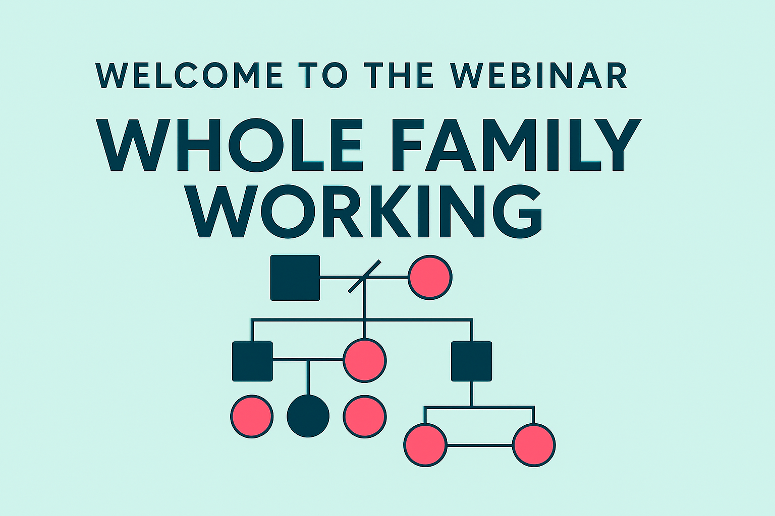
Whole Family Working
To coincide with Equal Parenting Week, HSCP/HSAB are hosting a free webinar on Whole Family Working along with the launch of the new HSCP Father Inclusive Practice guidance.
Hear how practitioners should take a child‑centred, whole‑family approach, seeing and hearing the child, understanding each family member’s needs, and recognising how these needs affect one another.
Sessions available:-
9:30-10:30am – Tuesday 28 April
4-5pm – Wednesday 29 April
9:30-10:30am – Friday 1 May
More information see the attached flyer and book your place here:- Event List (scroll down on page)

Slide 6
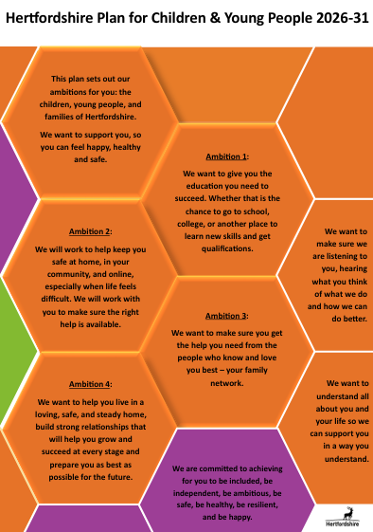
Plan for Children & Young People 2026-31
The Plan for Children & Young People 2026-31 sets out Hertfordshire County Council's ambitions for improving outcomes for children and young people and how those ambitions will be enabled. The vision is to support all children and young people to feel they belong and are happy, healthy, and safe so they can thrive with their families and community.
supported by a Plan on a Page and an animation which share key information about the four ambitions and what these mean to young people. These are hosted, along with full Plan, at Hertfordshire's plan for children and young people 2026-31 | Hertfordshire County Council.
You are welcome to share these with the families, young people and children who you work with.

Slide 7

Hertfordshire Teenage Pregnancy and Young Parents Strategy 2026-2028
The strategy sets out our shared ambitions to reduce unplanned teenage pregnancy, support young parents, address inequalities, and strengthen the confidence and skills of our workforce.
To support professionals when working with young people around relationships and sexual health, you can check out our dedicated guidance hub here:
https://publichealth.hertscc.gov.uk/enews/rsheguidance/introduction/introduction
If you would like to discuss this further in any operational team meetings, please contact Stephanie.Ebsworth@hertfordshire.gov.uk
Hertfordshire Teenage Pregnancy and Young Parents Strategy 2026 – 2028

Slide 8

Supporting a Healthy Pregnancy - FREE masterclass for pregnant women in Herts
Monday 11th May 6pm - 7:30pm
Guidance on nutrition during pregnancy
Advice on how to stay active
Tips on managing commons issues, including morning sickness, sleep and indigestion
Signposting to other support services
A chance to ask our expert team any questions
Sign up here now for free if you’re an expectant mum in Hertfordshire!
You can also get a wider range of support and advice from the Love Your Bump team here

Slide 9
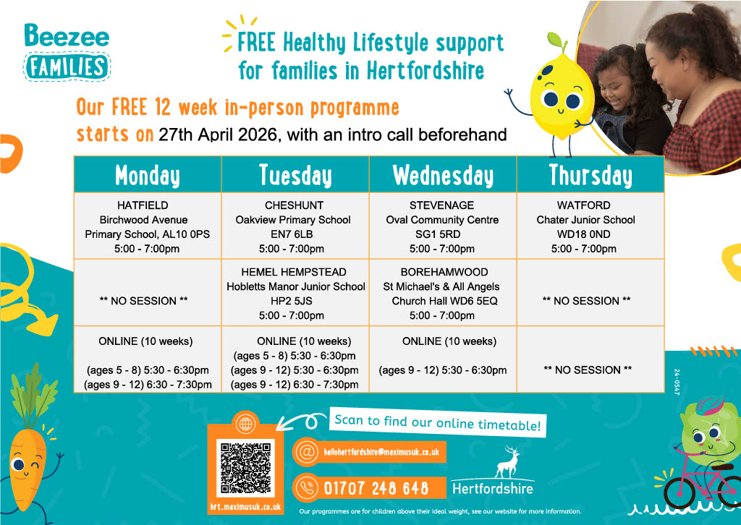

Slide 10
My Teen Brain Training
Strategic Partnerships Commissioning are pleased to announce the next My Teen Brain Online Training courses that are due to be delivered on:
Thursday 7th May 2026
Thursday 4th June 2026
Please find the booking link below for you to reserve your place on one of our Autumn term courses. This training is a very popular and is beneficial to all practitioners who work with Hertfordshire children and families.
If you are interested in booking on to the course, please ensure that you ONLY reserve your place if you have the capacity to attend the training on your preferred day and for the entire duration of the session, from 10am – 3pm.
Thursday 7th May - My Teen Brain Online Training - 7 May | Hertfordshire County Council
Thursday 4th June - My Teen Brain Online Training - 4 June | Hertfordshire County Council

Slide 11
The Bridge
Our Intensive Family Support Team in Welwyn Hatfield will be restarting The Bridge, which is a support group designed for parents, carers and young people in school years 6,7 and 8 who are struggling with school attendance. This includes those who are not attending school at all or on a significantly reduced timetable. Some of the topics covered are:-
Anxiety and worries related to school
Friendships and social dynamics
Health and wellbeing
Neurodiversity
The Future
You can find out more on the attached leaflet and sessions will run for 12 weeks starting on Thursday 16th April 2026—9th July 2026, 12:30pm-2:30pm at Welwyn Garden City Cricket Club, 288 Knightsfield, WGC, AL8 7NQ
Please contact Alison.cowie@hertfordshire.gov.uk or karina.saunders@hertfordshire.gov.uk if you have any questions.

Slide 12
SEND Provision Plan Consultation Now live 23 March to 15 June 2026
The Hertfordshire SEND Local Area Partnership has developed a SEND Provision Plan 2026-29 which supports the delivery of the new SEND Strategy for 2026–2029. The strategy sets out our shared ambitions to improve outcomes for children and young people with Special Educational Needs and Disabilities (SEND).
As part of the SEND Provision Consultation running from 23 March to 15 June 2026, we are seeking your views on whether the plan reflects your priorities, and how it can be further strengthened before it is finalised.
You can share your feedback by completing a short survey or by attending one of our consultation events. All details on how to get involved are available on the Local Offer: www.hertfordshire.gov.uk/SENDProvisionPlan
Feedback gathered so far has helped identify key priorities and has informed the five core elements of the draft SEND Provision Plan:
Strengthen capacity in mainstream schools
Expand specialist capacity in mainstream schools
Create more special school places
Update special school designations
Child centred placements
Thank you for your time, your views are important to us. All responses will be carefully considered and will directly influence the final SEND Provision Plan for 2026–2029.

Slide 13

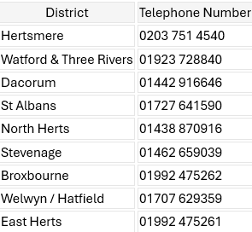
Hertfordshire Family Support Service (FFS)
District Contact Numbers (Professionals Only)
The Family Support Service works with families from pregnancy until their child starts primary school (0–5 years). Our aim is to ensure every child has the best possible start in life, supporting their development, wellbeing, and resilience. We offer a blend of universal, emerging needs, and targeted support, tailored to each family’s circumstances.
What the Family Support Service Offers:
Universal Support (available to all families)
Support for Emerging Needs
Targeted Family Support
How to Refer a Family
hertfordshire.gov.uk: Family Centre Referral

Slide 14

Get September Ready with Services for Young People
Services for Young People is offering ‘Get September Ready’ sessions throughout the summer to help Year 11 students feel more confident and prepared for their next steps after school. The free sessions are open to all young people in Hertfordshire who are finishing Year 11 and who would benefit from support with the transition to their next step.
Whether they are going into sixth form, college or don’t currently have anything in place for September, they can get individualised support from qualified Services for Young People CEIAG Advisers. The informal sessions are particularly beneficial for young people who have been out of education, are home-educated, or have special educational needs and disabilities, including those with social, emotional and mental health needs.
Read the full story with dates and locations of the 2026 Get September Ready sessions

Slide 15

Stevenage Inclusive Job Fair – Step2Skills
Thursday 14th May 10am-2pm
Location: Stevenage Football Club, Broadhall Way, Stevenage SG2 8RG
Meet employers to find out about local opportunities and the skills they are looking for
Chat with Step2Skills Supported Employment team
BSL Interpreter available all day
Quiet hour bookable
Contact: 01992 556194
step2skills@hertfordshire.gov.uk

Slide 16

Corporate Parenting Strategy 2026-2031
Hertfordshire County Council has launched Your Care, Your Future: Our Corporate Parenting Strategy 2026–2031, which sets out our vision, values, and priorities for supporting care‑experienced children and young people. The five‑year timeframe reflects our commitment to providing stability and continuity during local government reorganisation.
When a child or young person comes into our care, Hertfordshire County Council becomes their corporate parent. However, corporate parenting is a shared duty across all partners, services, and professionals who play a role in a child’s life. By working together, we aim to create an environment where young people feel safe, supported, and equipped to thrive as they grow into adulthood.
The strategy is shaped by what young people told us matters most to them. Their insights have formed seven key priorities that will guide our work over the next five years: belonging, aspiration, confidence, wellbeing, stability, participation, and feeling protected.
Find out more and listen to care-experience young people’s message to us as corporate parents: www.hertfordshire.gov.uk/corporateparentingstrategy

Slide 17


SEND Events & Activities
Booking is now open for SPACE May events and activities
Events and Activities for Neurodivergent Children and Young People. No diagnosis necessary.
Upcoming QbCheck appointments and Dyscalculia screenings at SPACE
In addition, the special educational needs or disabilities (SEND) community directory is a resource that brings together and promotes groups and organisations that offer activities and support for children and young people aged 0-25 with SEND and their families.
Special Educational Needs and Disabilities | Hertfordshire Directory
Summer Term Workshops - now open for booking
Events and Activities by SPACE HERTFORDSHIRE | Eventbrite

Slide 18

Relationship Support
When working with families do you think about the quality of parental relationships?
Do you feel confident to ask questions about relationship quality?
Do you know where to signpost for relationship support?
We understand that healthy relationships support good outcomes for children, so it is essential that we support parents to have the skills to manage stress and communicate well.
Arguing is NORMAL it is our behaviours and how we resolve conflict that determine relationship quality and stability.
The Strategic Partnerships Commissioning Team have developed an i-learn that we can share for free if you have a learning platform you can host the course on.
It covers:
Understanding what parental conflict is and the impact this has on Children and Young People
Understanding the difference between parental conflict and domestic and the appropriate support pathways
Identifying signs that could indicate relationship distress and conflictual behaviours that lead to relationships breakdown
Understanding a framework for working with parents in conflict
We offer free training in the use of the OnePlusOne Digital Interventions and are looking for relationship support champions across the VCFSE sector.
We have developed a webpage full of resources and courses to support parents in conflict Relationship support for parents | Hertfordshire County Council
We have commissioned 3 online courses for parents through the charity OnePlusOne
Me, You and Baby Too
Arguing Better
Getting It Right for Children
We have practitioners trained across the Family Centre Service and Local School Partnerships that can support parents and carers through the digital resources or parents can be signposted to complete the resources independently by creating a free account
We have trained practitioners and commissioned providers delivering group interventions for parents
Parenting When Separated
Co-Parenting with Care for parents of children with SEND
Stronger Relationships
If you would like to know more about the training, resources and courses available to support parental relationships please contact CSStrategic.Partnerships@hertfordshire.gov.uk
Hertfordshire County Council

Slide 19

Parenting Courses
Targeted parenting courses are commissioned by Strategic Partnerships Commissioning team, within the Joint Children’s and Young People Commissioning Service and through the Targeted Parenting Framework (TPF).
They will meet the most common parenting needs in Hertfordshire and will be a key contributor to the overall package of support that a parent receives. Parenting courses to be delivered as part of a wider package of intervention and not in isolation. Six providers have been commissioned through the Strategic Partnerships Commissioning team :-
ADD-vance
Families in Focus
Family Lives
Families feeling safe
SPACE
Supporting links.
There is NO cost for families to attend.
Further information about workshops can be found on The SEND Local Offer and
Parenting directory .
Links to special edition newsletters:
Families First News – Parenting & Relationship Support
Families First News - Welcome to the Workforce Development Special Edition

Slide 20
Key Families First Links
Keep up-to-date by reading o latest Families First: Families First News
Link to support for families:- Families First Website
Professionals area:-Early Help – information for professionals and partners
For Families First partnership groups, news sharing and general info email:- familiesfirst.support@hertfordshire.gov.uk
Ensure your service is listed on the Hertfordshire Directory:- Register to add a listing | Hertfordshire Directory

