Slide 1
Families First News sharing Keeping in Touch KAREN DORNEY HEAD OF SERVICE SUPPORTING FAMILIES | CHILDRENS SERVICES
DECEMBER 2024

Slide 2
HAPpy Camps are back this winter
Hertfordshire County Council is once again launching its free winter activity camps for children and young people in Hertfordshire.
Fully funded holiday activity camps return for the festive break, providing eligible children and young people with the chance to meet friends, learn new skills and enjoy nutritious food.
Camps are running on selected dates from 23 December – 3 January and places can be booked via the Herts Sports Partnership’s website
Codes will be issued via Schools

Slide 3
Introduction to the SEND Local Offer website New Webinar Dates
A friendly face from the Local Offer team will take you through what’s on the website and how you can use it to find the right services and support. www.hertfordshire.gov.uk/localoffer
(For professionals) Tuesday 14 January 11am – 12pm Join the meeting
(For professionals) Thursday 16 January 2pm - 3pm Join the meeting
(for professionals AND parent carers) Tuesday 14 January 8pm - 9pm Register to join this webinar

Slide 4
Male Role Model Programme
Our St Albans and Dacorum Intensive Family Support Team are co-ordinated a new Male Role Model Programme which is male-led and child focussed.
It has started due to a lack of support for male role models and grew from a drop-in group, developing into a programme promoting advice and guidance for male role models from all backgrounds. You can download a poster for course dates and times, both online and in person.
Next face-to-face course starts 8th Jan, 6.30-8.30pm in St Albans EMAIL ifst.dacorum&stalbans@hertfordshire.gov.uk for details and
PLEASE SPREAD THE WORD

Slide 5
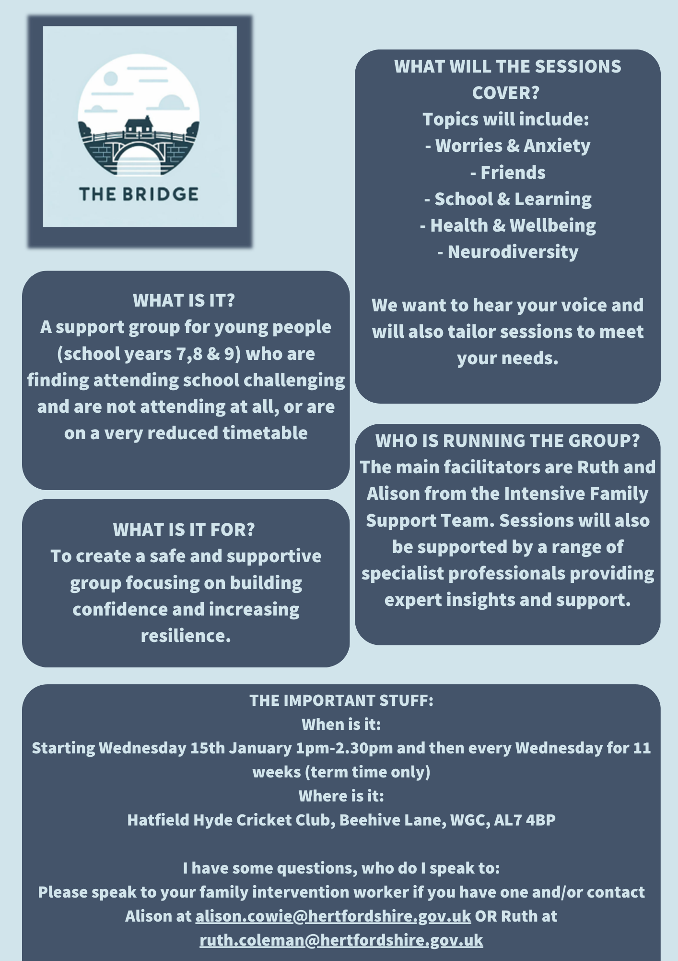
The Bridge Group
The Bridge Group is an 11-week programme for young people and parents where the YPs are not regularly attending school. This is aimed at Yrs. 7,8 & 9.
It is starting on Wednesday 15th January, 1pm-2.30pm then every Wednesday for 11 weeks and being held at Hatfield Hyde Cricket Club, Beehive Lane, Welwyn Garden City, Al7 4BP
The sessions include:
2 x sessions on anxiety, worries and low mood facilitated by CWP practitioners
Physical health & wellbeing co-facilitated with Herts Sports Partnership
Neurodiversity co-facilitated with SPACE
The future co-facilitated with Services for Young People
They will also be covering friendships, family, school/learning
For more information contact:- Alison.Cowie@hertfordshire.gov.uk or Ruth.Coleman@hertfordshire.gov.uk

Slide 6
Relationship Support
When working with families do you think about the quality of parental relationships?
Do you feel confident to ask questions about relationship quality?
Do you know where to go for relationship support?
We have developed a webpage full of resources to support parents in conflict and a range of digital and group based courses:
Parenting when Separated
Parenting SEN children Through Separation
One Plus One Digital Interventions:-
Arguing Better
Me, You and Baby Too
Getting It Right For Children

Slide 7
Parenting Courses
Targeted parenting courses are commissioned by Family and Health Services Commissioning through the Targeted Parenting Framework (TPF). They will meet the most common parenting needs in Hertfordshire and will be a key contributor to the overall package of support that a parent receives. Parenting courses to be delivered as part of a wider package of intervention and not in isolation.
Six providers have been commissioned through Family and Health Services Commissioning team:-
ADD-vance
Families in Focus
Family Lives
Families feeling safe
SPACE
Supporting links.
There is NO cost families to attend.
Further information about workshops can be found on The SEND Local Offer and Parenting directory .

Slide 8
Hertfordshire Young People’s Health and Wellbeing Survey 2024 is open until Friday 20 December!
The objectives of this survey are to:
Enable young people to share their views and feedback on a number of issues.
Provide secondary schools with useful data on their pupil population, including trend data over time.
Provide commissioners and a range of agencies with useful data on the Hertfordshire young person population, including trend data over time.
Enable effective commissioning and service delivery that meets the needs of Hertfordshire's young people.
The survey contains questions on a number of issues including:
Mental health and wellbeing
Drugs and alcohol
Healthy eating and physical activity
Relationships
Safety and bullying
To access the survey, follow the link below or use the QR code in the image,
www.hertshealthevidence.org/yphws

Slide 9
Beezee January 2025 programmes – NOW OPEN!
Previously known as BeeZee Bodies, Beezee is now the name given to healthy lifestyle programmes delivered by Maximus, and they continue to partner with HENRY. All of their programmes are funded by Hertfordshire County Council’s Public Health team.
Support is available in-person and online.
Professionals can refer families and young people to these programmes, or families and young people can sign up directly.
Please see the attached Beezee Families Timetable for programmes starting the week commencing 20th January 2025 which offer FREE support for 12 weeks!

Slide 10
Support and services available to manage the cost of living
This winter, Hertfordshire County Council wants to make sure that advice and support is available to help every resident deal with the rising cost of living.
Practical help is available for those who need it most. To make sure everyone knows what financial and practical support is available, the council is highlighting advice and services Hertfordshire residents can access.
Help to manage the cost of living | Hertfordshire County Council

Slide 11
Hertfordshire Community Foundation Cost of Living response
Household Support Fund - HCC/govt funding to address cost of living crisis for most disadvantaged adults and families – in the last 12 months have funded 57 groups with over £400,000 – over 30,000 beneficiaries
Community Spaces – since funded through HSF have made 46 grants with £84.5k provide safe space for residents to escape the cold or the heat and gain advice – reduce isolation
Hertfordshire Children’s Fund – help for families – application via professional referral route eg health visitor, tenancy support, social worker – in the last 12 months 198 families benefited from grants totaling £60,000 av just over £300
HCF Grants Apply here - £360,000 available HSF6
For more info: www.hertscf.org.uk
grants@hertscf.org.uk
01707 251351

Slide 12
Welcome Space Network Home Energy Support
Communities 1st are delivering for Cadent.
‘Warm Space’ centres were the initial response in supporting individuals affected by ongoing cost-of-living pressures. Evolving from this initiative, a Welcome Hub is a safe community space that is accessible for everyone to attend on a regular basis. A variety of activities are delivered by staff and volunteers, with free or low-cost refreshments provided.
For more information see below:

Slide 13
Phoenix Programme
The Phoenix Programme is a scheme to support female survivors of Domestic Abuse, rebuild confidence and develop skills to gain sustainable employment.
Please cascade this information to your colleagues.
Please see below for more information:
Programme Pocket Guide and Referral Form

Slide 14
Sunflower News – December
Please see below Sunflower News December edition and information on Safer Places.
For those needing a helping hand?
V i s i t o u r W o m e n ’ s C e n t r e i n H a r l o w a n d W a l t h a m C r o s s
SAFERPLACES.CO.UK

Slide 15
Stevenage LiFE Course: January 2025
This completely FREE course is running for students that live in Stevenage or close by at Stevenage Fire Station from Tuesday 28th – Friday 31st January 2025 and they will be holding an induction evening on Tuesday 14th January at 6.30pm for anyone referred to attend with a parent / guardian.
Please note that no spaces are offered until after this induction evening.
For more information, please see flyer below:
The course is for young people between the ages of 13-16 years of age who usually fall into one or more of the
following categories:
• Received exclusions from school
either permanently or temporarily
• Problems at home or school
• Easily led
• Persistent offending/antisocial
behaviours
• Lack of self-esteem/confidence
• Lack of rules/boundaries
• Anger issues/confrontational
• Victim of bullying/crime
• History with fire

Slide 16
Families First Dates for Your Diary!
Join a Families First Induction day - ideal for new starters
We host Families First online Induction days 4 times per year, where various early help services give a 20 minute whistle-stop tour of their service and are attended by new internal CS staff and external partners. The next dates are:-
15 January 2025
Come along to a Working Together Events - HOLD THE DATES
We are finalising the venues and speakers for our next Working Together in Early Help events which will be taking place across the county in February 2025. We will shortly be sharing an invitation and agenda for these events, so please watch this space!
Thursday 6th Feb | 10-1pm | Broxbourne BC, Council Chambers
Thurs 13th Feb | 10-1pm | Bowes Lyons, Stevenage
Mon 10th Feb | 10-1pm | Peartrees, Welwyn Garden City
Thus 27th | 10-1pm | Three Rivers council

Slide 17
Focused Fortnight - Lite Bite Session on dental hygiene and headlice
Our Intensive Family Support Teams held a Focus Fortnight in November on individual aspects of neglect in direct work which focused on dental health and health eating.
You can find out more about some of the information shared by downloading the leaflets below:-
Watch out for future focus fortnights

Slide 18
Key Families First Links
Keep up-to-date by reading o latest Families First: Families First News
Link to support for families:- Families First Website
Professionals area:-Early Help – information for professionals and partners
For Families First partnership groups, news sharing and general info email:- familiesfirst.support@hertfordshire.gov.uk
Ensure your service is listed on the Hertfordshire Directory:- Register to add a listing | Hertfordshire Directory

