Slide 1
Families First News sharing Keeping in Touch SUE CHAPMAN SERVICE MANAGER SUPPORTING FAMILIES | CHILDRENS SERVICES
FEBRUARY 2025

Slide 2
New look FF Panels & Practice Team
FF Panels Team and Supporting Families Practice Team have merged – new team; name TBC!
Key functions remain: Panels, Family Support Co-ordinators, supporting & partners with EHM to record early help work with families
Challenging time for the new team (staff leaving, staff absence, vacancies and new processes); appreciate your patience & understanding over next few months
Promise to keep you updated along the way!
Serena Yearwood
Team Manager
Helen Whyman
Senior Families First
Co-ordinator
Dilshani Salgadoe
Family Support
Co-ordinator
Gill Alcock
Family Support
Co-Ordinator
Jackie Brewin
Families First
Co-ordinator
Shelly Cook
Families First
Co-ordinator
Karen Dorney
Head of Service
Vacancy
Family Support
Co-ordinator
Kenzie Howlett Family Support Co-ordinator
Mandi Tsamados
Senior Families First
Co-ordinator
Sophie Page
Families First
Co-Ordinator
Jacky Reynolds
Families First
Co-ordinator
Sue Chapman
Service Manager
Vacancy
Senior Support Officer
(Resources)
Georgina Lusby
Support Officer
(Resources)
Louise Watt
Business Support Officer
(Resources)
Notes:
As part of the Organisational Resourcing Programme the shape of the Families First Panels and Supporting Families Practice Teams has changed.
We said thank you and farewell to wonderful colleagues. We’re happy to say that some have stayed in HCC: Holly Turl and Suzanne Paisley are now Children’s Practitioners and Leroy Williamson has returned to his SFIW role. Rebecca Clarke is applying to roles, including some in HCC and others have already secured new roles elsewhere: Mel Hurworth, Victoria Poorer. We wish them all well in their new adventures.

Slide 3
Parenting Courses
Targeted parenting courses are commissioned by Family and Health Services Commissioning through the Targeted Parenting Framework (TPF). They will meet the most common parenting needs in Hertfordshire and will be a key contributor to the overall package of support that a parent receives. Parenting courses to be delivered as part of a wider package of intervention and not in isolation.
Six providers have been commissioned through Family and Health Services Commissioning team:-
ADD-vance
Families in Focus
Family Lives
Families feeling safe
SPACE
Supporting links.
There is NO cost families to attend.
Further information about workshops can be found on The SEND Local Offer and Parenting directory .

Slide 4
Relationship Support
When working with families do you think about the quality of parental relationships?
Do you feel confident to ask questions about relationship quality?
Do you know where to go for relationship support?
We have developed a webpage full of resources to support parents in conflict and a range of digital and group based courses:
Parenting when Separated
Parenting SEN children Through Separation
One Plus One Digital Interventions:-
Arguing Better
Me, You and Baby Too
Getting It Right For Children

Slide 5
Reuse Shops Community Donations information
For colleagues in HCC, this intranet page has all the information including the link to make a referral: Reuse Shops Community Donations Scheme for households in need - Herts CC
For colleagues outside of HCC, you can find information here on the internet: Reuse | Hertfordshire County Council
The referral form is here: Reuse Shop Community Donation form - Professionals

Slide 6
Herts Sport & Physical Activity Partnership Update
Park Play: Taking place every Saturday 10am-12pm in 4 parks across the county . (Please see the attached slide for more details.)
Apex 360 Update:
Free Park Tennis: Sessions run every Saturday from 10–11 AM at Coronation Fields, Bennetts End. These are fun and engaging tennis sessions open to everyone, completely free of charge. (Details in the attached flyer.)

Slide 7
HIGH FIVE Camps – half term activities
Due to a system change, eligible parents will now NOT require a booking code from their schools to secure their place(s). They simply need to click on the relevant link on the attached flyer to take them to the booking platform Kids Club HQ.
This camp is for children who are currently receiving benefits related Free School Meals so if you are able to share this information to those families who may benefit from these camps, we would be most grateful.
Should you have any questions, please do not hesitate to contact sarah.hunt@apex360.co.uk | www.apex360.co.uk
Please see below for more information about the February HIGH FIVE Camps which are now live and available to book!

Slide 8
SEND Coffee Morning
Informal coffee morning to listen and chat to some experts in the field of SEND, and enjoy some coffee and cake!
Date: 26th February 2025
Time: 10am-12:30pm
Location: Otley Family Centre, Watford, Hertfordshire, WD19 7TB

Slide 9
Herts Haven Cafes
Herts Haven Cafés are a free welcoming drop-in space for children and young people aged 10-18 across Hertfordshire to access support for their emotional wellbeing.
They provide Herts Haven Cafés in Hemel Hempstead, Watford, Stevenage and Ware.
No referrals required.
Herts Haven Cafés - WithYouth.
You can find out more about Herts Haven Cafes by contacting the team on 0208 189 8400 or via email at cyp@hertsmindnetwork.org

Slide 10
Healthy Start
A national scheme to help young families and those who are pregnant, to access healthy food, milk and vitamins
Nearly £1M unused in Hertfordshire
It’s a simple online registration for those who are eligible, and they can receive:
£4.25 each week of pregnancy from the 10th week
£8.50 each week for children from birth to 1 year old
£4.25 each week for children between 1 and 4 years old

Slide 11
Safer Sleeping Training
Safer Sleep Week runs from 10-16 March 2025.
This year we are focusing our programme on giving every child the best start in life through promoting Smokefree homes and Smokefree pregnancies. Exposure to smoking in pregnancy and smoke in the home is a risk factor for stillbirth and Sudden Infant Death (SID).
Public Health are pleased to be able to offer free Smokefree training and Safer Sleeping training to frontline professionals that work directly with families, particularly those that visit families in their homes. In February (10th and 27th) our Adult Health Improvement Service is running free online Smokefree training (1 hour long), professionals that complete the training will then receive a link to access free Lullaby Trust Safer Sleeping training during 11-16th March 2025. To register for training please sign up here.

Slide 12
Protective Behaviours for Dads and male carers
Families Feeling Safe are offering a fully funded online course ‘Supporting Families with Protective Behaviours’ for Dads and male carers.
The new dates are 27th February – 4th April 7.00pm – 9.00pm.
This 6-week course can help:
Understand how Feelings, Thoughts and Behaviour link together
Understand what may be influencing their child’s behaviour
Respond to a range of feelings e.g. stress, anger, anxiety and worries
Improve communication to build better relationships
Build on their own and their child’s strengths
Learn strategies to help them and their child/ren feel safe
Please share these details to your colleagues who may want to refer a parent and to Dad’s and male carers who may need this support.
For further information and to reserve a place, please email enquiries@familiesfeelingsafe.co.uk or Tel: 07850 518216
For more information:-

Slide 13
My Teen Brain Online Training
Please find below the booking link for you to reserve your place on to one of our courses.
Thursday 13th February 10am – 3pm My Teen Brain Online Training | Hertfordshire County Council
Tuesday 4th March 2025 - My Teen Brain Online Training | Hertfordshire County Council
Thursday 20th March 2025 - My Teen Brain Online Training | Hertfordshire County Council
If you would like further information about our courses, please email CSStrategic.Partnerships@hertfordshire.gov.uk
There are still some spaces left on the My Teen Brain Online Training course on Thursday 13th February 2025.
This 1-day CPD course, from 10am – 3pm for Hertfordshire practitioners working with parents of teenagers and/or working with teenagers or young people in Hertfordshire.
It provides an opportunity to understand teenage brain development and the adolescent developmental process and consider both risk and resilience. It includes ideas and strategies for professionals working with teenagers and their parents to help them cope with challenging feelings and behaviour and to support young people in an emotionally healthy context. The day brings together the latest understanding from neuroscience and developmental psychology and the principles of The Nurturing Programme from Family Links The Centre For Emotional Health.

Slide 14
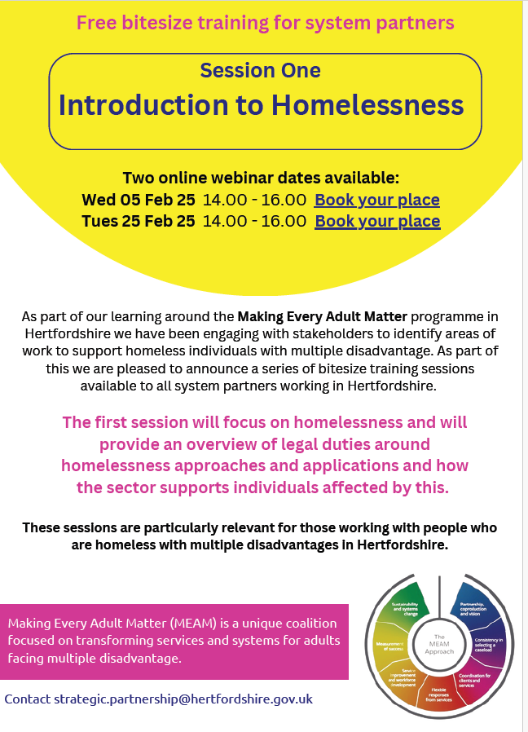
Introduction to Homelessness - Webinar
There is still time to book on to the Introduction to Homelessness webinar.
Date: Tuesday 25 Feb 2025
Time: 14.00 – 16.00
BOOK HERE
Leaflet attached below:

Slide 15
Understanding Trauma
A Programme for Parents in Herts whose children have experienced sexual abuse
Trauma Recovery CIC's Butterflies Community are able to offer a funded 6 session Understanding Trauma Programme for Parents in Herts whose children have experienced sexual abuse, with the option of joining a peer support group after.
It's a free, psychoeducational programme that offers an opportunity for parents to become empowered by understanding their child's trauma, and become equipped with tools and support to aid their child's and their own healing.
The first session is on 28th February 2025 (online)
Parents/Carers self-refer via the leaflet.
Please visit www.trcic.org for further information.

Slide 16
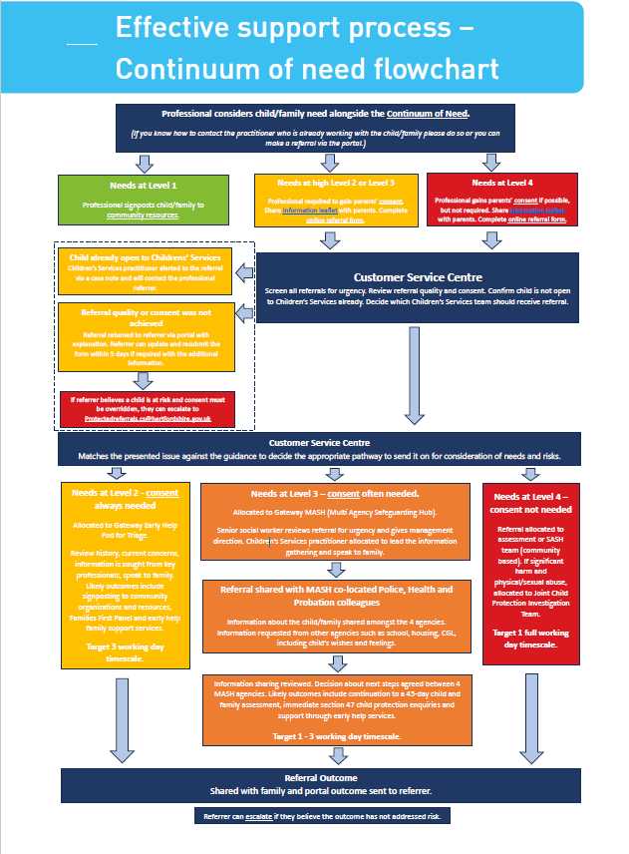
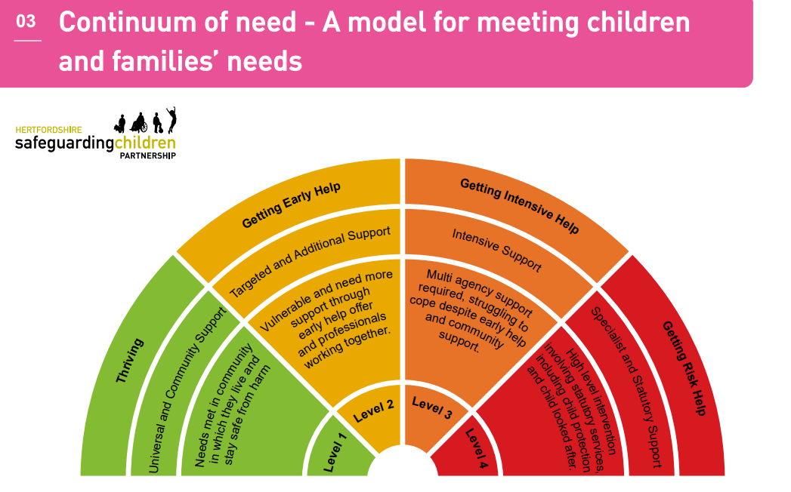
Refreshed Continuum of Need
Hertfordshire’s Continuum of Need has recently been refreshed.
You can view the document together with a very useful flowchart for professionals to use when making referrals to Children’s Services.
Information for professionals and volunteers | Hertfordshire County Council

Slide 17
Prevent
Updated Prevent National Referral Form 2025
We have successfully established a 3-way referral pathway for Prevent referrals in Hertfordshire through the Multi Agency Prevent Board and Counter-Terrorism Police partnership.
Using the updated Prevent National Referral Form 2025, referrals will now go to CTP Prevent, the Fixed Intelligence Management Unit and the MASH.
This new referral route ensures that all referrals are assessed by the relevant teams, with safeguarding needs and non-CT risks addressed by appropriate partners.
Please use the updated Prevent National Referral Form (January 2025) for all future referrals.
Download the form here:-

Slide 18
FREE Healthy Homes for Healthier Lives Training
The Public Health team at HCC in partnership with the district and borough council Environmental Health and Housing departments teams, are delivering FREE training sessions that will address:
Why there is an increased spotlight on damp and mould in Hertfordshire and what we are doing to address this.
The relationship between housing quality, conditions, defects, and health, including the various causes and risk factors that affect those at highest risk.
The role of Environmental Health and Housing Departments, their powers and limitations.
How to assess risk and use Hertfordshire's referral pathway.
The role of those involved in renting in the social and private sector, including the responsibility of tenants, landlords and agencies.
Please share this opportunity with your colleagues and or any relevant partners.
Please see below for upcoming dates and registration links:
18th February 2025 (10.00 – 11.30am) – please sign up here
4th March 2025 (10.00 – 11.30am) – please sign up here
18th March 2025 (10.00 – 11.30am) – please sign up here
Any questions, please contact the Healthy Places Public Health team: healthyplaces@hertfordshire.gov.uk

Slide 19
Key Families First Links
Keep up-to-date by reading o latest Families First: Families First News
Link to support for families:- Families First Website
Professionals area:-Early Help – information for professionals and partners
For Families First partnership groups, news sharing and general info email:- familiesfirst.support@hertfordshire.gov.uk
Ensure your service is listed on the Hertfordshire Directory:- Register to add a listing | Hertfordshire Directory

