Slide 1
Families First News sharing Keeping in Touch Chris O’Conner SERVICE MANAGER SUPPORTING FAMILIES | CHILDRENS SERVICES
JULY 2025

Slide 2
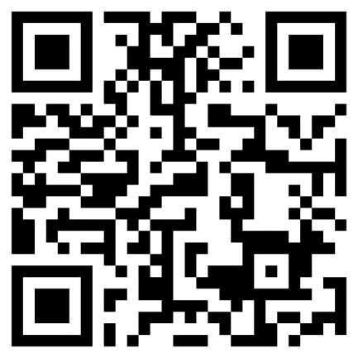
Prevent Awareness Training for Venue Hire Staff – 3 new sessions
This session is aimed at staff who are responsible for taking bookings for venues/rooms or who regularly book speakers and works alongside the guidance issued within your local area and your own venue hire policy. There are sessions available on:
Thursday 25th September || 14:00-15:00
Tuesday 28th October || 10:00-11:00
Wednesday 26th November || 10:00-11:00
All sessions are held via MS Teams and calendar invite with the joining link will be sent to you upon registration.
You can register onto one of the sessions via our registration form. QR code:

Slide 3
Supporting Links - Courses
A 6-week group for parents and carers of children 2-19yrs with any
additional need. Your child does not need a diagnosis.
• Understand your child’s behaviour
• Develop strategies that really work
• Reduce conflict and increase co-operation
• Improve emotional regulation
• Explore sensory needs
• Increase your child’s resilience
• Manage the different needs within your family
Talking Additional Needs for parents of children aged 2 to 19 years:
Wednesdays 5th, 12th, 19th, 26th November. 3rd & 10th December.
7pm to 9pm
At Reddings Family Centre, Harcourt Road, bushey. WD23 3PE
Share with any parents and carers who would benefit from attending this popular course

Slide 4
Families in Focus
A complete guide to parenting children with Autism and/or ADHD – for parents of children either on a pathway or with a diagnosis.
This course is for those parenting a child from 2 years to 11 years, living in Hertfordshire and able to participate in interactive Zoom sessions and attend every week.
A complete guide to parenting children with Autism and/or ADHD Tuesday mornings from 9.30am to 11.30am on September 9th, 16th, 23rd, 30th & October 7th, 14th (no session over half term) & November 4th, 11th, 18th
A complete guide to parenting children with Autism and/or ADHD Tuesday evenings from 6.30pm to 8.30pm on September 9th, 16th, 23rd, 30th & October 7th, 14th (no session over half term) & November 4th, 11th, 18th
Handling anger of children with Autism and/or ADHD – for parents of children either on a pathway or with a diagnosis.
This course is for those parenting a child from 4 years to 11 years, living in Hertfordshire and able to participate in interactive Zoom sessions and attend every week.
Handling anger of children with Autism and/or ADHD Wednesday mornings from 9.30am to 11.30am on September 10th, 17th, 24th & October 1st, 8th, 15th
Handling anger of children with Autism and/or ADHD Wednesday ‘lunch & learn’ from 12.30pm to 2pm on September 10th, 17th, 24th & October 1st, 8th, 15th
Handling anger of children with Autism and/or ADHD Wednesday evenings from 6.30pm to 8.30pm on September 10th, 17th, 24th & October 1st, 8th, 15th
Web: www.familiesinfocus.co.uk
Email: bookings@familiesinfocus.co.uk

Slide 5
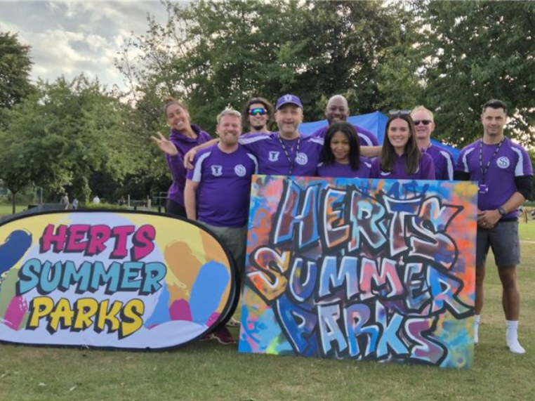
Herts Summer Parks
Free park activities across Hertfordshire August 2025
Registration for Herts Summer Parks 2025 is now open. If you are aged 12–16 years, a parent or carer of a young person, you can sign up now which will enable fast track entry on the day: https://forms.office.com/e/NSu0aCDSpa
For full details on the activities running across the three-week programme and information about our food providers, please visit our website: https://sportinherts.org.uk/Summer-Parks
Event Dates and Locations:
Welwyn – King George V Playing Fields: Monday (4th, 11th, 18th) August
Watford – King George V Playing Fields: Tuesday (5th, 12th, 19th) August
Hertsmere – Meadow Park: Wednesday (6th, 13th, 20th) August
Broxbourne – Waltham Cross Playing Fields: Thursday (7th, 14th, 21st) August
Stevenage – King George V Playing Fields: Friday (8th, 15th, 22nd) August

Slide 6
HAPpy Camps
HAPpy Camps – bookings now open
Available for children / teens who get benefits-related free school meals.
Codes available from schools
Find Activities HAPpy Activity Camps

Slide 7
Lumi Nova helping children with confidence building & news school worries this summer
The summer holidays are a great opportunity for parents/carers to use Lumi Nova to support their children with common worries. Whether it's the start of a new school year, transitioning to a new school / class or making new friends, Lumi Nova offers a wide range of goals to support children build confidence.
Lumi Nova is available to families in Hertfordshire in partnership with Herts Mind Network as part of their With Youth Digital Wellbeing Service.
Lumi Nova supports children to build confidence and learn lifelong skills to manage their worries through an intergalactic adventure game!
The offer is free and instantly accessible to families by visiting: withyouth.org/lumi-nova and clicking ‘GET ACCESS NOW’.

Slide 8
With Youth online wellbeing summer groups
Help Herts children/young people enjoy summer whilst preparing for autumn changes by encouraging them to join an online emotional wellbeing group. With Youth’s free Digital Wellbeing Service for 5-18s is launching age-appropriate online groups this month
https://buff.ly/yRLEiRJ

Slide 9
Sign up to CYPMHS newsletter
Hertfordshire's Children and Young People’s Mental Health Services (CYPMHS) system newsletter is below, for all professionals working with children and young people in Hertfordshire. Have a look and find out the latest news, information, updates on the progress of the CYPMHS System Redesign, events and much more:
http://herts-cypmhs.tfemagazine.co.uk/current.default.aspx

Slide 10
Watford LiFE Course: September 2025
The LiFE Course will be running , from Watford Fire Station on Tuesday 23rd – Friday 26th September 2025
Hertfordshire Fire & Rescue Service delivers the LiFE course, which is a 4-day programme, delivered by firefighters, based on the role of a firefighter.
This programme is aimed at young people aged between 13- 16 years old, who may be having challenges at school, have poor attendance, displaying anti-social behaviour or are at risk of exclusion or offending, and/or have low confidence and self-esteem. Please see the attached link for full entry requirements: life-entry-criteria.pdf (hertfordshire.gov.uk).
Complete this referral form giving as much information as possible and then email it to hfrs.youth@hertfordshire.gov.uk

Slide 11
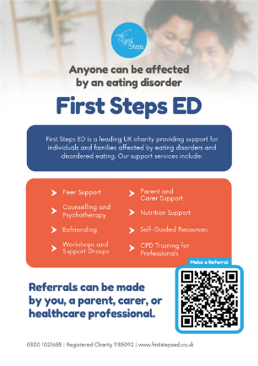
First Steps ED
First Steps ED offer various free early help support options for 5–18-year-olds in Hertfordshire with eating disorders/disordered eating. This includes group workshops, one-to-one sessions, and easy-to-access self-help guided resources. Children and young people don’t need to be physically unwell due to their eating behaviours to ask for support – it’s always best to ask for help as soon as possible. Eating disorders can happen to anyone at any time. First Steps ED support is on hand for anyone regardless of ability, background or identity.
Find out more on their website: Services & Support | First Steps ED

Slide 12
Young Carers – new iLearn available
This 30 minute iLearn course has been developed with Carers In Hertfordshire / Young Carers team to explain how and why we need to identify and help support our young carers.
Please complete the course if you work with families.
HCC Internal link: Welcome to iLearn+:
External Link – eLearning Courses
Download the poster here:-

Slide 13
Parenting Courses
Targeted parenting courses are commissioned by Strategic Partnerships Commissioning team, within the Joint Children’s and Young People Commissioning Service and through the Targeted Parenting Framework (TPF).
They will meet the most common parenting needs in Hertfordshire and will be a key contributor to the overall package of support that a parent receives. Parenting courses to be delivered as part of a wider package of intervention and not in isolation.
Six providers have been commissioned through the Strategic Partnerships Commissioning team :-
ADD-vance
Families in Focus
Family Lives
Families feeling safe
SPACE
Supporting links.
There is NO cost for families to attend.
Further information about workshops can be found on The SEND Local Offer and
Parenting directory .

Slide 14
Relationship Support
The Strategic Partnerships Commissioning team have developed a webpage full of resources to support parents in conflict and a range of digital and group based courses:
Stronger Relationships: A 6-week group based course for co-parents living together or apart that focuses on managing stress and enhancing communication.
Parenting When Separated: A 6-week group based course for separated parents that focuses on the emotional impact of separation and supporting communication between co-parents.
Co-Parenting with Care: A 6-week group-based online course for parents and carers of neurodiverse children seeking guidance, support, and strategies for co-parenting more consistently.
OnePlusOne’s digital interventions: 3 online courses aimed at new parents, intact parents and parents that are separated:
Arguing Better
Me, You and Baby Too
Getting it right for children
Relationship support details
If you would like to know more about the training, resources and courses available to support parental relationships please contact CSStrategic.PartnershipsCommissioning@hertfordshire.gov.uk.

Slide 15
Key Families First Links
Keep up-to-date by reading o latest Families First: Families First News
Link to support for families:- Families First Website
Professionals area:-Early Help – information for professionals and partners
For Families First partnership groups, news sharing and general info email:- familiesfirst.support@hertfordshire.gov.uk
Ensure your service is listed on the Hertfordshire Directory:- Register to add a listing | Hertfordshire Directory

