Slide 1


Families First
News sharing
Keeping in Touch
Karen Dorney
Head of Service
SUPPORTING FAMILIES | CHILDRENS SERVICES
June 2026

Slide 2
Other Workforce Development
Opportunities
Join a Families First Induction Session - ideal for new starters
We host Families First online Induction days 3 times per year, where various early help services give a 20-minute whistle-stop tour of their service and are attended by new internal CS staff and external partners.
This is now covered in 2 sessions and our next dates are am on Wednesday 8th July 2026 and pm on Thursday 16 July via Teams. If you have any new staff or would like to hear more about early help services, please email: familiesfirst.support@hertfordshire.gov.uk
Consider a Workforce Shadowing Opportunity
Workforce shadowing provides a great opportunity to find out more about other services, what they do and how they might be able to support you in your work. It also enhances communication across agencies and helps strengthen and develop professional relationships, building local networks. Visit Workforce development to make a request

Slide 3
FF Partnership Meetings
The June round of Partnership Meetings are underway, dates are as follows:
North Herts – Wednesday 3rd June – 10am – 12pm – The Sadie Centre, Letchworth
Dacorum/St. Albans – Wednesday 10th June – 10am-12pm venue ?
Watford, Three Rivers + Hertsmere – Thursday 11 June –2pm – 4pm Three Rivers BC
East Herts – Tuesday 16th June – 2pm-4pm – online
Stevenage – Thursday 18th June – 10am-12pm – Stevenage BC
Welwyn/Hatfield – Tuesday 23rd June – 10am-12pm – The Hive, Hatfield
Broxbourne – Friday 3rd July – 10am-12pm Broxbourne BC
Please email: familiesfirst.support.hertfordshire.gov.uk if you would like an invite or an opportunity to present your service

Slide 4

It’s Young Carers Week
Will you take action this week and beyond, to make a real and lasting difference in the lives of young carers?
Unsupported young carers may face significant challenges balancing their own needs aspirations with caregiving responsibilities. Emotional stress, social isolation, academic struggles and their physical caring role can impact their well-being and future opportunities if not understood and supported.
If you think someone you know may be a young carer, please visit: www.hertfordshire.gov.uk/youngcarers for further information and support and/or contact the team YoungCarers@hertfordshire.gov.uk .
PLEASE NOTE:
For those involved in Families First Assessments (FFA) : Previously the question about young carers referred to Carers in Hertfordshire. As of today, the FFA mirrors the new YC support pathway: Young carers – information for professionals | Hertfordshire County Council

Slide 5
Other Support for Carers

Slide 6
Best Start Family Hub & Healthy
Babies Partnership events
We need your support!
In Hertfordshire, we are building on the strong foundations of our Family Centre Service to introduce Best Start Family Hubs, strengthening how we support children, young people and families. If you are a professional working with children and young people in Stevenage (0–19, or up to 25 with SEND), we warmly invite you to join us for this important partnership event at either Watford or Stevenage.
This event will be an opportunity to come together, share perspectives, and help shape a joined‑up approach that puts families and children at the centre.
At the event, we will:
Hear about the shared ambitions for joining up services in line with the Best Start in Life Strategy.
Explore what families have told us matters most when accessing services, and how we can deliver on these priorities through our Best Start Local Plan.
Co‑produce the Best Start Family Hub network model, agreeing how we work in partnership and our collective commitment to improving outcomes for children and families.
Dates, times and venues:
Stevenage event: Mon 29th June 2026, 09:30AM - 12:00PM at the Hertfordshire Development Centre, Six Hills Way, Stevenage, SG1 2FQ
Watford event: Tues 30th June 2026, 09:30AM - 12:00PM at The Hive, Croxley Park, Hatters Lane, Watford, WD18 8AS
Book your place now - https://bit.ly/4tS2Sjf

Slide 7

Health and development advice for families and those working with young children
Hertfordshire's Family Centre Service have very useful information and webinars for you to share with families on the topics of:-
Oral Health: Oral Health Webinar
Toilet Training: Toilet Training Webinar
Sleep webinar: Sleep Webinar
Boundaries & Behaviours webinar: Boundaries and Behaviours Webinar
Transitions: Transitions webinar

Slide 8



Help shape our research on
For Baby’s Sake
We are sharing an opportunity for frontline practitioners who may have previously referred families into For Baby’s Sake to attend a 2.5 hour workshop which will provide invaluable support in shaping our future evaluation design.
Potential dates for the workshops are Wednesday 17th June and Thursday 18th June but please scan the QR code or click on the link below to register your availability and someone will contact you.
https://forms.office.com/Pages/ResponsePage.aspx?id=RlPdFXOeJEKjVLb7C-0Tt5jc8c860m9InGY7iY4LRadUN0JUQTVURkQ2TUxBREMwN0JLVzM0OElBTS4u&origin=QRCode

Slide 9

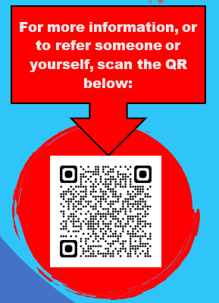
The Mr Programme
The Mr Programme is running again for 8 weeks starting on 1st July 2026 at 7pm till 9pm at Greenhills site, Tenzing Road, Hemel Hempstead. HP2 4HS.
This programme is for males aged 18 or over who are role models to children so dad’s, uncles, brothers , neighbours and friends.
Please use/ share the QR code to input the adults details. We will be covering a range of topics such as:
Men’s mental health
SEND in children
Children’s mental health
Separation and conflict
Women’s hygiene and support males can offer
Supporting babies and newborns – shaken baby syndrome , tools to cope and manage with challenges
Signposting to external services for support

Slide 10
Crisis and Resilience Fund
Replaces the Household Support Fund with a stronger focus on early intervention and prevention
Aims to reduce financial hardship and build long-term resilience
Delivered in partnership to ensure timely, targeted support
To support residents struggling with food and essential costs the following is available:
Five Dinners – Get you personalised meal plan & shopping list every week. Sign up and register under Hertfordshire County Council for free – usually £6.99 per month. Offers a range of healthy, affordable recipes
Community supermarkets – find a wide range of healthy food options and everyday essentials - all priced under £1.
Free school meals – check child eligibility
Food support – Community organisations supporting food costs, options include:
  Foodbanks – Free food support for those struggling
  Food Pantries – Various models, often pay what you can
  Food Parcels – Food support for those with additional needs or living in rural areas
  Community Supermarkets – A much reduced cost supermarket
Olio – find produce from local businesses which is nearing its sell-by date
Too Good To Go – buy surplus unused food from restaurants, cafes and supermarkets.
Help to manage the cost of living | Hertfordshire County Council
Hertfordshire County Council

Slide 11
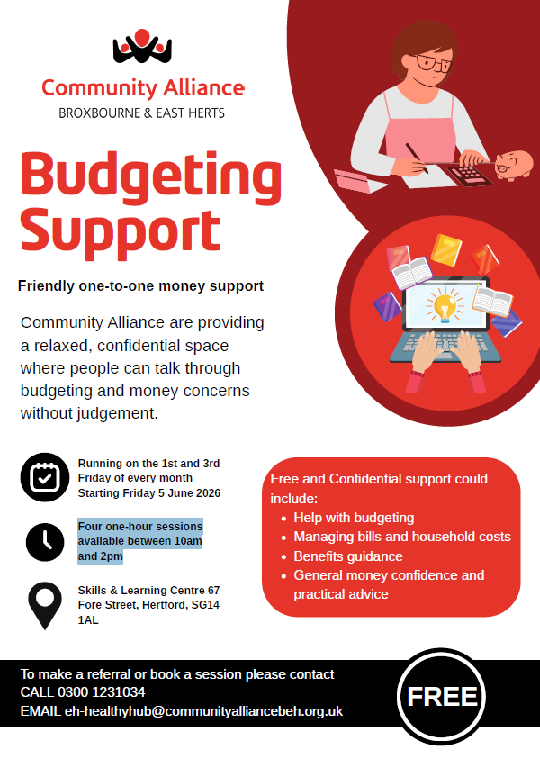
Budgeting Support
Community Alliance are providing a relaxed, free and confidential space where people can talk through budgeting and money concerns without judgement.
They will have four one‑hour sessions available between 10am and 2pm, running on the 1st and 3rd Friday of every month, starting Friday 5 June 2026 at the Skills & Learning Centre 67 Fore Street, Hertford, SG14 1AL.
To make a referral or book a session please contact CALL 0300 1231034 or email
eh-healthyhub@communityalliancebeh.org.uk

Slide 12
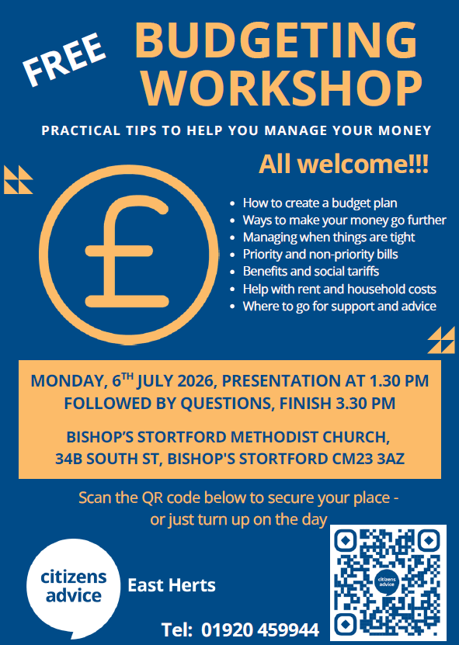
Budgeting Workshop
Citizens Advice East Herts are holding a free budgeting workshop at the Bishop's Stortford Methodist Church on:
Monday, 6th July 2026 from 1.30 pm to 3.30 pm.
They'll be explaining how to create a budget plan, the difference between priority and non-priority bills, how to maximise your income and reduce expenditure when things are tight, and what help is available.
Please share with the families you support.

Slide 13


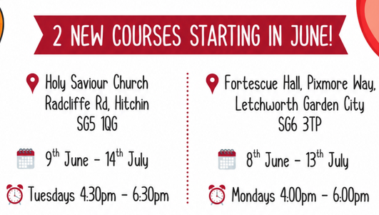

Free 6 week cooking courses for families

Slide 14

Free personalised meal plans for Hertfordshire families, usually £86 per year – now FREE (until April 2027)!
Hertfordshire County Council and the local district and borough councils are working with TV chef Theo Michaels, to help local families eat healthier, reduce food costs and make life around dinnertimes a lot easier! Join the FiveDinners website and every week you’ll get a fully personalised meal plan with a complete shopping list so you know exactly what you’ve got for dinner without having to think about it!
To claim your free membership today simply visit your exclusive link:
https://FiveDinners.com/MyCommunity and scroll down to Hertfordshire.
Visit: FiveDinners.com/MyCommunity

Slide 15

BeeZees: Supporting a Healthy Pregnancy
FREE masterclass for expectant parents in Herts
2 Weeks to go!
Supporting a Healthy Pregnancy Online Masterclass on Monday 22nd June 6pm - 7:30pm
Guidance on nutrition during pregnancy
Advice on how to stay active
Tips on managing commons issues, including morning sickness, sleep and indigestion
Signposting to other support services
A chance to ask our expert team any questions
Sign up here now for free if you’re an expectant parent in Hertfordshire!
+ NEW FOR SUMMER 2026 – Step Up to Secondary (SUTS) for year 6 eligible* children and families. Join us in person at Breaks Manor Youth & Community Centre in Hatfield, or online, for 6 weekly sessions of healthy habit building fun! Step Up to Secondary - Free 6-Week Programme - Beezee by Maximus

Slide 16

Safer Sleep to be added to EYFS
The Government is expected to update the Early Years Foundation Stage Statutory Framework in September 2026, setting out clear standards regarding safe sleeping for all infants and children.
Key messages for Early Years providers are to ensure babies are:
Always placed on their backs to sleep on a clear & firm flat mattress
Checked regularly while sleeping & dressed appropriately to avoid overheating
Providers should
Be familiar with the Lullaby Trust guidance on safe sleeping
Review and update your safer sleep policy in line with Lullaby Trust guidance
Ensure all staff, including new starters, receive safer sleep training (such as that provided by Lullaby Trust or SANDS)
Check sleep environments throughout the day to ensure they are clean and clear
Keep up to date with national guidance and EYFS updates
(Department for Education article: Help for early years providers : Safer sleep)
Notes:
Presenter notes: The Government is expected to update the Early Years Foundation Stage Statutory Framework in September 2026 in response to the tragic death of two infants, who died due to unsafe sleeping practices in two separate early years settings.
The EYFS will now set out clear standards regarding safe sleeping for all infants and children and Early Years providers can use the Lullaby Trust guidance on safe sleeping, and must keep up to date with national guidance and the new EYFS updates

Slide 17

HSCP - Supporting Individuals and Families with lived experience of Domestic Abuse - FREE!
Friday 12 June 2026 (09:30 - 13:30)
Description: This 4-hour interactive session is focused on exploring whole family approaches to responding to individuals with lived experience of domestic violence. It will consider how to utilise multi-agency working and navigating your role as a key link in the system chain to safeguard impacted individuals.
Please visit our website
Or book:
Event : Supporting-Individuals-and-Families-with-lived-experience-of-Domestic-Abuse - 36079
Who Should Attend: This session is designed for professionals in a variety of sectors, who work directly or indirectly with families affected by domestic abuse. This may include, but is not limited to, social care, health, education, police, probation, and drug and alcohol abuse services.

Slide 18

Residents’ survey 2026
Have your say on living in Hertfordshire. The county council is asking residents to share your thoughts on your local area, council services and how you like to be kept informed. This information will be used to improve services and help deliver a sustainable, inclusive and thriving Hertfordshire. What matters most to you? Share your views and help shape the services that are important to you. Complete the survey by Sunday 12 July:
www.hertfordshire.gov.uk/residentsurvey

Slide 19
Hertfordshire Parenting and Relationship Support Summer newsletter
You can view the Summer 2026 Parenting and Relationship Support Offer Newsletter which will provide you with information and details on Parenting Courses and Relationship Support offer.
Please can you ensure you cascade to your teams. If you have any questions please email CSStrategic.Partnerships@hertfordshire.gov.uk .
View the latest copy here:- hertfordshire_parenting_and_relationship_newsletter_sum26.pdf

Slide 20
Supporting Links - Talking Families
Delivered online using Zoom
6, weekly sessions for parents and carers of children under 12, sharing tips on how to:
Manage challenging behaviour with consistency
Encourage positive behaviour
Build your child’s self esteem
Set and maintain boundaries
Respond to tantrums and difficult feelings in children
Develop a strong parent/child relationship now and for the future
To book please quote course ID: 833
Email: bookings@supportinglinks.co.uk
Phone: 07512 709556
Mondays, 8.00 to 9.30pm
(Course ID 833)
1st, 8th, 15th, 23rd, 29th June & 6th July 2026
Wednesdays, 9.45 to 11.15am
(Course ID 832)
3rd, 10th, 17th, 24th June, 1st & 8th July 2026

Slide 21

Parent Alienation Workshop
Coram Family Lives will be delivering the below online parenting workshops (via MS Teams), funded by Herts County Council in the Summer term for parents/carers who live in Hertfordshire or who have a child attending a Hertfordshire school.
This workshop is designed to support separated/divorced parents and protect parent-child relationships.
Parent Alienation Workshop
Tuesday 7 July, 9.30 to 11.30am, Online - MS Teams
Thursday 9 July, 7pm to 9pm, Online - MS Teams
To book a place please click here Coram Family Lives - Parent Alienation Workshop Referral Form for our online referral form or scan the QR code on the attached flyers
You can also email services@familylives.org.uk or call us on 0204 522 8700 or 0204 522 8701 for more information.

Slide 22
My Teen Brain
This FREE 1-day CPD course, from 10am – 3pm is for Hertfordshire practitioners working with parents of teenagers and/or working with teenagers or young people in Hertfordshire. It provides an opportunity to understand teenage brain development and the adolescent developmental process and consider both risk and resilience. It includes ideas and strategies for professionals working with teenagers and their parents to help them cope with challenging feelings and behaviour and to support young people in an emotionally healthy context. The day brings together the latest understanding from neuroscience and developmental psychology and the principles of The Nurturing Program from The Centre For Emotional Health.
Please find the booking link below for you to reserve your place on one of our Autumn term courses. This training is a very popular and is beneficial to all practitioners who work with Hertfordshire children and families.
Target Audience: Practitioners working with parents of teenagers and/or working with teenagers or young people
🕒 30 June 2026, 10:00-15:00– Virtual via MS Teams
Please click the link below to book your place:
My Teen Brain Online Training 30 June | Hertfordshire County Council
Please ensure that you ONLY reserve your place if you have the capacity to attend the training on your preferred day and for the entire duration of the session
If you would like further information about the course or alternative dates, please email CSStrategic.Partnerships@hertfordshire.gov.uk

Slide 23

Relationship Support
When working with families do you think about the quality of parental relationships?
Do you feel confident to ask questions about relationship quality?
Do you know where to signpost for relationship support?
We understand that healthy relationships support good outcomes for children, so it is essential that we support parents to have the skills to manage stress and communicate well.
Arguing is NORMAL it is our behaviours and how we resolve conflict that determine relationship quality and stability.
HCC provides a range of FREE resources and training to help professionals confidently support families experiencing interparental conflict.
A dedicated professionals webpage with guides, videos and toolkits.
Recognising and Supporting Parents in Parental Conflict eLearning Module. This course explores what parental conflict is and how it differs from domestic abuse, how to identify conflict and what support is available for parents and carers in conflict. You can access the training via i-learn HSAB and HSCP training and resources | Hertfordshire County Council
Attend the Families First Induction Sessions for an overview presentation.
The OnePlusOne Getting on Better e-learning is a self-guided course designed to build practitioners’ confidence in supporting parents to improve their relationships. Across four modules, it covers the impact of parental conflict, recognising domestic abuse, using the resources, and applying learning in practice. You can access the training by completing the OnePlusOne Getting on Better e-learning training request form
We have developed a webpage full of resources and courses to support parents in conflict Relationship support for parents | Hertfordshire County Council
We have commissioned 3 online courses for parents through the charity OnePlusOne
Me, You and Baby Too
Arguing Better
Getting It Right for Children
We have practitioners trained across the Family Centre Service and Local School Partnerships that can support parents and carers through the digital resources or parents can be signposted to complete the resources independently by creating a free account
We have trained practitioners and commissioned providers delivering group interventions for parents
Parenting When Separated
Parenting When Separated for parents of children with SEND
Restoring Parent Connection in Difficult Times
If you would like to know more about the training, resources and courses available to support parental relationships please contact CSStrategic.Partnerships@hertfordshire.gov.uk
Hertfordshire County Council

Slide 24





The Hertfordshire Directory
If you offer a great Hertfordshire service, large or small, join hundreds of your peers and reach a wider audience.
Used by social workers, health and community professionals as well as members of the public to find good quality information, it is easy to create
a great listing like this one!
We will send you an annual reminder to keep your details up to date.
Did you know there is also a Referral Button to enable quick and secure professional- or self-referrals to service providers.
Scan the QR code to
get started, or view our short videos to set up your account and create one or more listings
Using the Hertfordshire Directory - YouTube
Find more Information for professionals or contact the HCC Web Team for help web.team@hertfordshire.gov.uk

Slide 25
Key Families First Links
Keep up-to-date by reading o
latest Families First:
Families First News
Link to support for families:-
Families First Website
Professionals area:-Early Help – information for professionals and partners
For Families First partnership
groups, news sharing and general info email:- familiesfirst.support@hertfordshire.gov.uk
Ensure your service is listed on the Hertfordshire Directory:- Register to add a listing | Hertfordshire Directory

