Slide 1


Families First
News sharing
Keeping in Touch
Karen Dorney
Head of Service
SUPPORTING FAMILIES | CHILDRENS SERVICES
OCTOBER 2025

Slide 2
Young Carers Professional Development Requirement Survey
The Council is refreshing the all-age Carers Strategy for 2026-2029 and designing how young carers will be supported in Hertfordshire from April. As part of this process, we are seeking feedback from all professionals who work with children, families, or adults to understand any professional development requirements.
Please find five mins to complete this survey to help us understand how best to help you in your day-to-day work with adults and children, where young carers may be identified and supported.
Please cascade to your team to complete.
Closes tomorrow !!!! 3rd October

Slide 3

SEND Summit
Key Themes Discussed:-
Accessing the right learning environment
Ensuring timely and effective EHCP delivery
Enhancing communication and collaboration
Building workforce capacity in education, health and care services
Improving equitable access to health services across the county
Strengthening transitions and post-16 support
Hundreds joined the SEND Summit this month, to help shape Hertfordshire's SEND services
The one-day event brought together over 100 parent carer representatives, school professionals, young people, voluntary sector organisations, professionals from the local authority, and the NHS. The recording of the Summit is now available online.

Slide 4

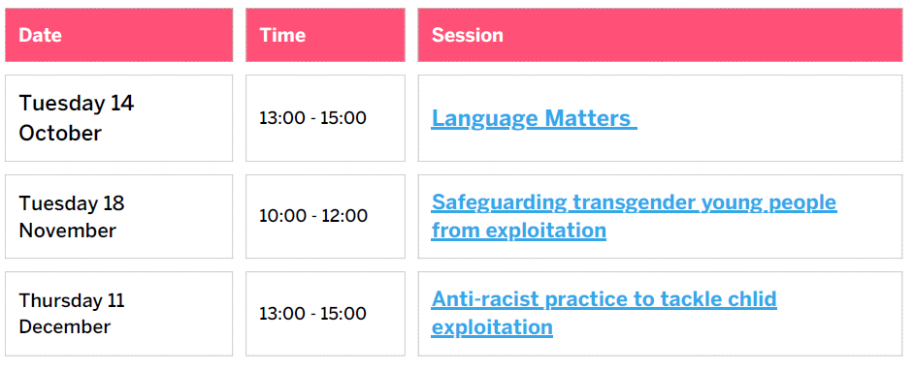
Children’s Society’s upcoming #LookCloser Programme of Learning events
October 2025 – December 2025.
#LookCloser is a partnership campaign between The Children's Society, the National County Lines Co-ordination Centre and the British Transport Police aiming to raise awareness of child exploitation and abuse and to encourage the public and businesses to better identify and report concerns.
The campaign also seeks to challenge assumptions and victim stereotypes, highlighting that child exploitation can happen anywhere, and any young person can be a victim.
Download and book here:-

Slide 5

Hertfordshire Sport & Physical Activity
Partnership: Annual Conference
Partners are invited this year’s Conference with the theme, “Crime Reduction Through Sport”. They will explore how sport can be a powerful, evidence-based tool to prevent and deter criminal behaviour. The conference will bring together leaders, practitioners, and policymakers to share insights, strategies, and success stories, with workshop options.
Taking place on Wednesday, 3rd December 2025 at the Fielder Centre, Hatfield.
Keynote contributions from:
Jonathan Ash-Edwards, Police and Crime Commissioner for Hertfordshire
Nicholas Buxton, High Sheriff of Hertfordshire
...alongside a range of expert speakers and facilitators.
Spaces are limited and demand is expected to be high, so we encourage early registration
If you have any questions, please don’t hesitate to get in touch.
Click below to book
https://www.eventbrite.co.uk/e/hsp-annual-conference-crime-reduction-through-sport-tickets-15118554

Slide 6
Hertfordshire Sport & Physical Activity
Partnership: More news
Funding Opportunity: Use Sport and Physical Activity to Reduce Serious Violence
We have just launched our second round of funding which closes on the 6th October. We are really looking for application that align where the data highlights there is a need specifically we would welcome application from community organisations in Hemel area.
https://sportinherts.org.uk/Crime-Reduction-through-Sport
This year’s Keeping Your Child Safe in Sport Campaign runs 6-12 October 2025 and we’re asking sports parents to play their part and talk to their children about how they can bring out their best through positive actions and support.
Any support from key organisations to push this out would be hugely appreciated
https://thecpsu.org.uk/safeinsport/

Slide 7
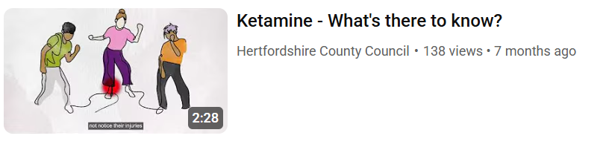
CGL Videos for Professionals
CGL would like to share a set of drug and alcohol awareness animations that they have produced in partnership with HCC.
These include specific animations on cannabis and ketamine which has a high prevalence in our young person population.
The animations are designed for professionals to support conversations around substance use and include how to have a conversation with someone about their drug or alcohol use.
All the animations can be found here:
Let's understand alcohol and drug dependency – YouTube
HCC’s Stigma campaign addressing the stigma around drug and alcohol use can be found here:
Let's break the stigma | Hertfordshire County Council

Slide 8
Introduction to the SEND Local Offer website – New webinar dates
The Local Offer website lets parents, young people and professionals know what special educational needs and disabilities services are available in Hertfordshire, and who can access them. There is so much more than that, too.
A friendly face from the Local Offer team will take you through what’s on the website and how you can use it to find the right services and support. www.hertfordshire.gov.uk/localoffer
  Monday 6 October 2pm – 3pm (for professionals): no need to book, save this joining link to your calendar
  Thursday 9 October 3pm – 4pm (for professionals - part of SEND Learning Week): Book your free place on the SEND Learning Week webinar
  Thursday 9 October 8pm – 9pm (for parents and professionals): Book your free place on the webinar
A quick note: The Local Offer website is different to Short Breaks (SBLO). We won’t be going into detail about SBLO.

Slide 9

HSCP Learning Hubs
The sessions will include: Case studies Provide practical tips Incorporate anti-discriminatory and anti-oppressive practice throughout Incorporate Whole Family Approach Incorporate a restorative/strength-based approach and a trauma informed approach Aim to provide a reflective safe space for delegates to explore their practice Explore practical approaches to adapting our practice to strengthen relationship based social work and relationships with families improving outcomes for children.
The next round of the HSCP Learning Hubs is on the topic of Working with Families when there are Challenges – Working with Resistance.
Download the poster
Bookings can be made via our website.
These sessions are FREE OF CHARGE to all professionals working with children and families in Hertfordshire.

Slide 10
FREE NHS Mental Health Awareness
Training – register today!
Working together to improve mental health
Join Hertfordshire and Mid Essex Talking Therapies for a free online Mental Health Awareness Training session on World Mental Health Day, Friday, 10th October, 11am-12pm. This session will help raise awareness of common mental health challenges and equip you with practical tools and techniques to support colleagues struggling with pressures at work, service users navigating challenging lives, and friends or family members in need.
This engaging session also includes guidance on how to connect people with local support through Hertfordshire & Mid Essex Talking Therapies.
Improving your understanding of mental health problems could benefit many people around you. Click here to register.
For more information about our service, please visit: www.hpft-talkingtherapies.nhs.uk

Slide 11

Herts Domestic Abuse Helpline
Herts Domestic Abuse Helpline is a confidential, free, support and signposting service for anyone affected by domestic abuse
  We are here to listen
  Call 08 088 088 088
  9am-9pm Monday to Friday and 9am-4pm weekends
Watch out for further communications to help promote the 16 days of activism campaign taking place between 25 November -10 December

Slide 12

Parenting Courses
Targeted parenting courses are commissioned by Strategic Partnerships Commissioning team, within the Joint Children’s and Young People Commissioning Service and through the Targeted Parenting Framework (TPF).
They will meet the most common parenting needs in Hertfordshire and will be a key contributor to the overall package of support that a parent receives. Parenting courses to be delivered as part of a wider package of intervention and not in isolation.
Six providers have been commissioned through the Strategic Partnerships Commissioning team :-
ADD-vance
Families in Focus
Family Lives
Families feeling safe
SPACE
Supporting links.
There is NO cost for families to attend.
Further information about workshops can be
found on The SEND Local Offer and
Parenting directory .
Links to special edition newsletters:
Families First News – Parenting & Relationship Support
Families First News - Welcome to the Workforce Development Special Edition

Slide 13


Relationship Support
The Strategic Partnerships Commissioning team have developed a webpage full of resources to support parents in conflict and a range of digital and group based courses:
Stronger Relationships: A 6-week group based course for co-parents living together or apart that focuses on managing stress and enhancing communication.
Parenting When Separated: A 6-week group based course for separated parents that focuses on the emotional impact of separation and supporting communication between co-parents.
Co-Parenting with Care: A 6-week group-based online course for parents and carers of neurodiverse children seeking guidance, support, and strategies for co-parenting more consistently.
OnePlusOne’s digital interventions: 3 online courses aimed at new parents, intact parents and parents that are separated:
Arguing Better
Me, You and Baby Too
Getting it right for children
Relationship support details
If you would like to know more about the training, resources and courses available to support parental relationships please contact CSStrategic.PartnershipsCommissioning@hertfordshire.gov.uk.

Slide 14



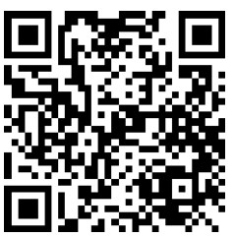
Families First Awards
The 2025 Families First Awards are closing on 15 October!!!
There are 6 team awards &
5 individual
Scan to make a nomination

Slide 15
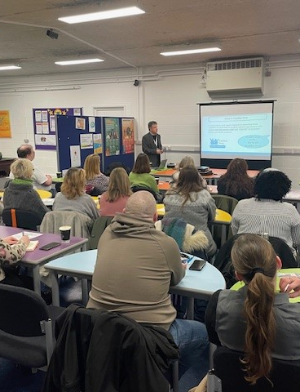
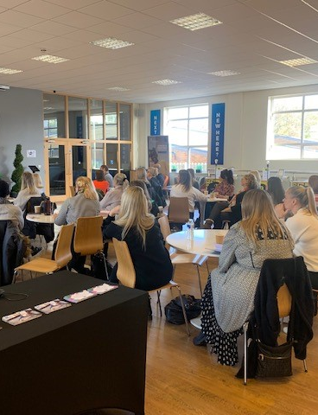
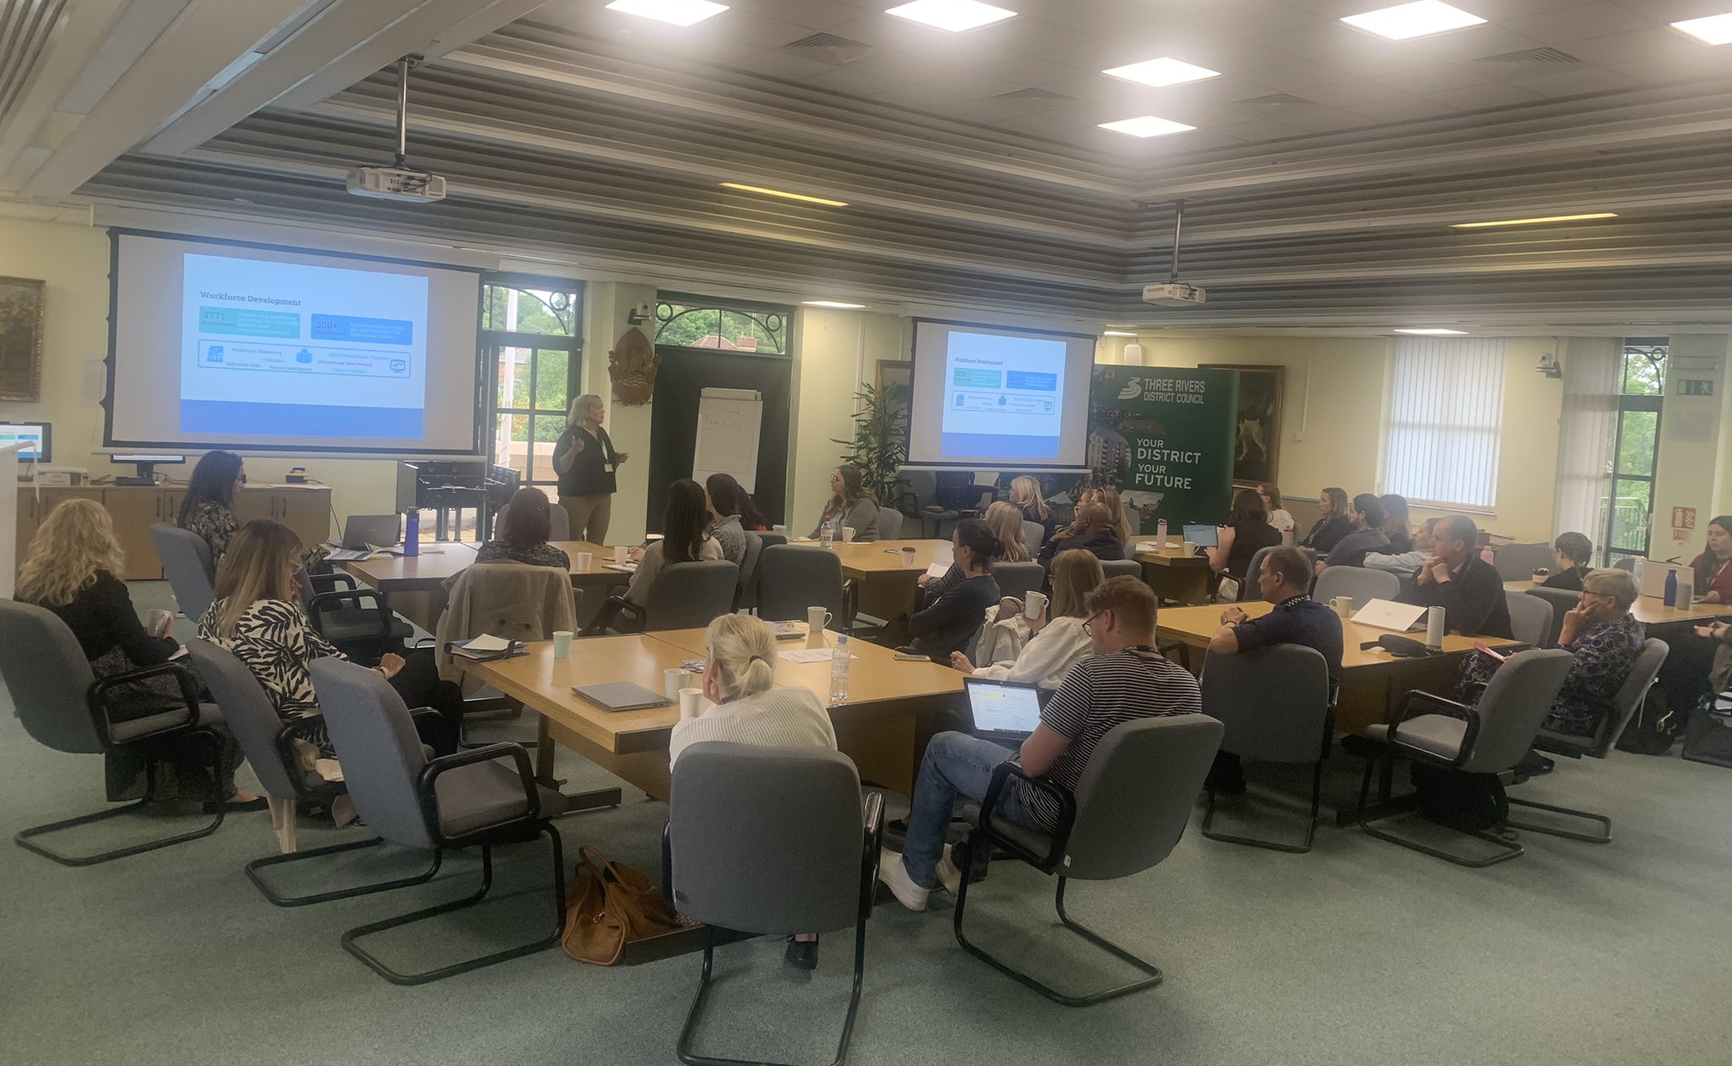
Working Together in Early Help
Join us this Autumn for our Working Together in Early Help learning event, which will focus on children and young people’s health and wellbeing.
We will have presentations from The Ollie Foundation, First Steps Ed, BeeZee Families and the HCC’s Emotional and Mental Wellbeing in Education (EMWIE) Team and is a great networking opportunity.
This event welcomes internal staff and professionals from partner agencies involved in supporting children, young people, parents, and families
Event locations, dates and times
  Monday 3rd November, 2pm-4:30pm, Three Rivers District Council, Three Rivers House, Northway, Rickmansworth WD3 1RL Book here
  Tuesday 18th November, 10am-12:30, VENUE: Broxbourne Borough Council, Bishops’ College, Churchgate, Cheshunt, EN8 9XQ Book here
  Tuesday 25th November, 10am-12:30, Bowes Lyons Young People's Centre, Stevenage, SG1 1XY Book here
  Thursday 27th November, 10am-12:30, The DSPL Hub, Fleetville School St Albans, AL1 4LW Book here

Slide 16
Key Families First Links
Keep up-to-date by reading o
latest Families First:
Families First News
Link to support for families:-
Families First Website
Professionals area:-Early Help – information for professionals and partners
For Families First partnership
groups, news sharing and general info email:- familiesfirst.support@hertfordshire.gov.uk
Ensure your service is listed on the Hertfordshire Directory:- Register to add a listing | Hertfordshire Directory

