Slide 1


Families First News sharing Keeping in Touch Karen Dorney Head of Service SUPPORTING FAMILIES | CHILDRENS SERVICES
SEPTEMBER 2025

Slide 2


Families First Awards
The 2025 Families First Awards are now open for nominations !!!
The awards are an opportunity to celebrate partnership working and showcase team and individual successes in Early Help that have made a significant impact to the lives of children, young people and families in Hertfordshire through their outstanding work and achievement of positive outcomes.
There are 6 team awards and 5 individual. View here:- 2025_families_first_categories.pdf
Make a nomination here:- Families First Awards 2025
Closing date for nominations is Wednesday 15th October 2025, 5pm
The Awards will be held at the South Hill Centre in Hemel Hempstead on Wednesday 12 November at 2pm and all shortlisted candidates will be invited along for an afternoon of celebration and cake!

Slide 3
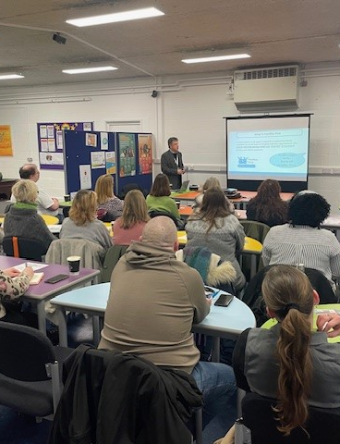
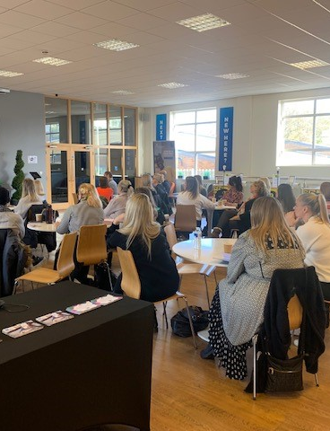
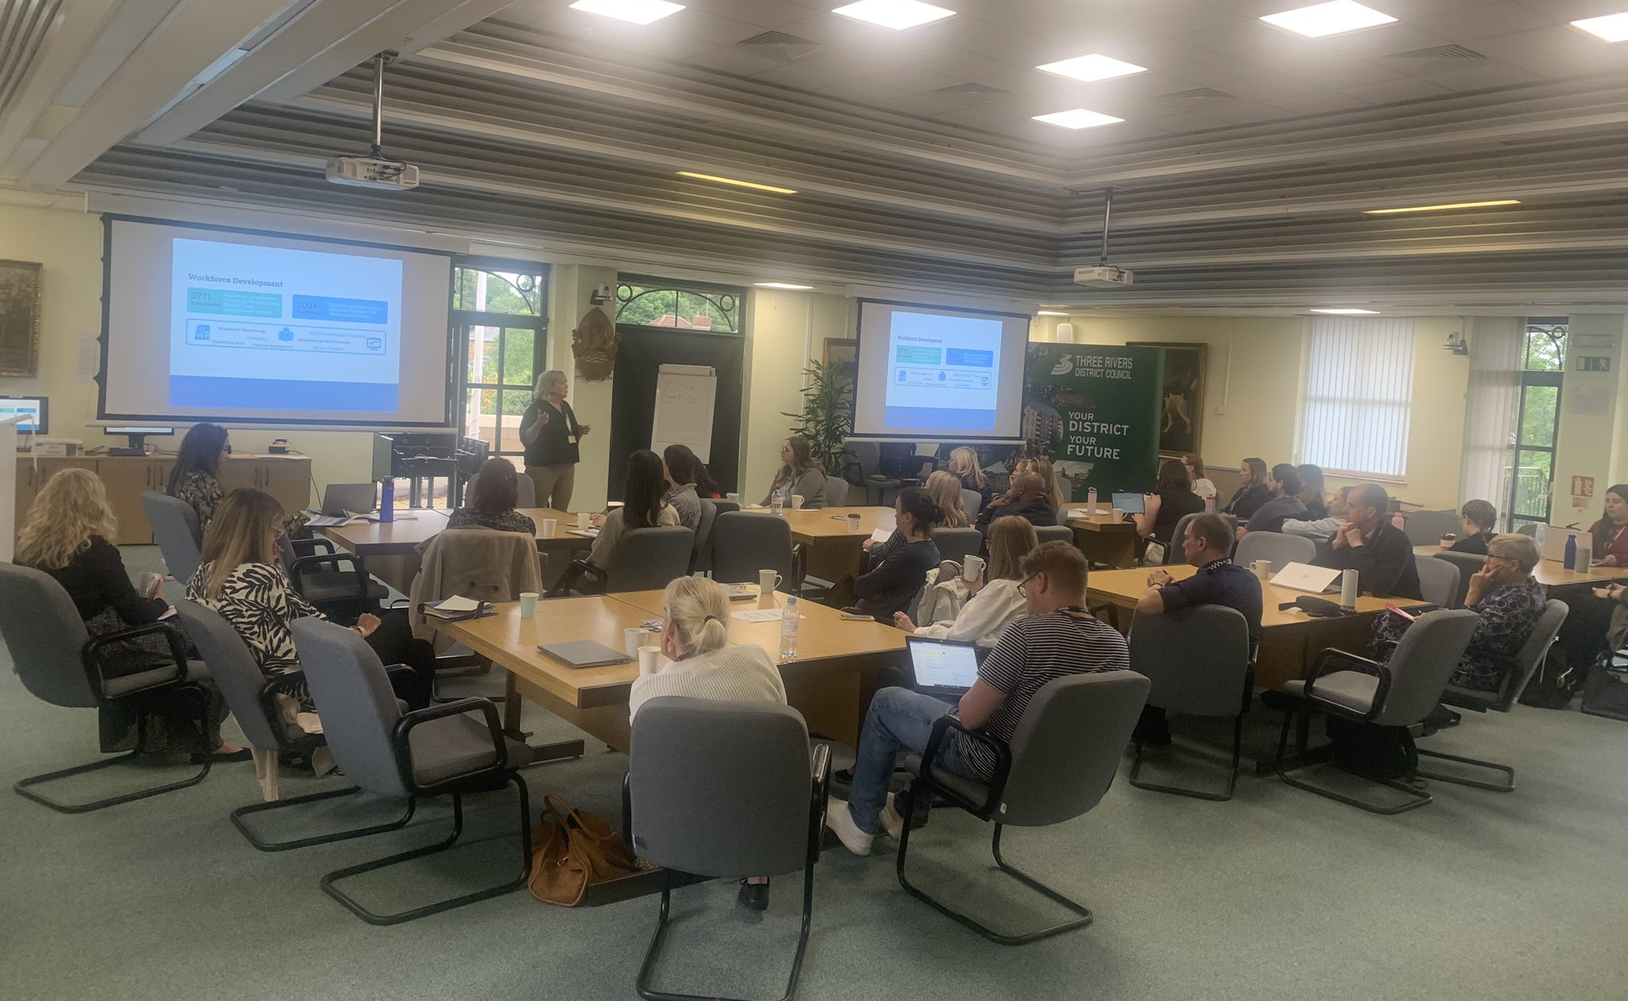
Working Together in Early Help
Join us this Autumn for our Working Together in Early Help learning event, which will focus on children and young people’s health and wellbeing.
We will have presentations from The Ollie Foundation, First Steps Ed, BeeZee Families and the HCC’s Emotional and Mental Wellbeing in Education (EMWIE) Team and is a great networking opportunity.
This event welcomes internal staff and professionals from partner agencies involved in supporting children, young people, parents, and families
Event locations, dates and times
Monday 3rd November, 2pm-4:30pm, Three Rivers District Council, Three Rivers House, Northway, Rickmansworth WD3 1RL Book here
Tuesday 18th November, 10am-12:30, VENUE: Broxbourne Borough Council, Bishops’ College, Churchgate, Cheshunt, EN8 9XQ Book here
Tuesday 25th November, 10am-12:30, Bowes Lyons Young People's Centre, Stevenage, SG1 1XY Book here
Thursday 27th November, 10am-12:30, The DSPL Hub, Fleetville School St Albans, AL1 4LW Book here

Slide 4
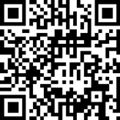
Hertfordshire Violence Against Women & Girls (VAWG) Survey
Hertfordshire County Council and Police are undertaking a survey to understand people's views and experiences of Violence Against Women and Girls (VAWG) in Hertfordshire. The results from this survey will be used to inform and shape Hertfordshire's new Violence Against Women and Girls Strategy and help us understand what more can be done to prevent these forms of abuse by listening to lived experiences.
Everyone that lives in, works in or visits Hertfordshire are invited to take part in this survey. Although the survey uses the term ‘Violence Against Women and Girls’ throughout, responses are welcome from everyone regardless of their gender identity, age, sexuality, ethnicity or background.
Help us promote:-
The survey can be accessed using the link below, or by scanning the QR code in the top corner of this email.
https://surveys.hertfordshire.gov.uk/s/8PJ5MA/
The survey is now open and will close on Friday 19th September. Please note that translation options will be available starting next week for the following languages: Gujarati, Polish, Punjabi, Romanian, Ukrainian, and Urdu.

Slide 5

CAP Money Coaching Courses Sep and Nov 2025
CAP have two courses running soon:
1. in September at Alexandra Road Congregational Church, 19 Alexandra Road, Hemel Hempstead, HP2 5BS. This is an evening course
2. in November at the Liberty Tea Rooms, 12 Bank Ct, Hemel Hempstead, HP1 1BS during the day
Full details can be downloaded here:
The course teaches how to create a budget and then how to live within it. It is suitable for anyone, no matter what their financial situation. It’s fine for people to redo the course if they have done it before.
As well as teaching, we provide tools for people to record/manage the budget plus ongoing support if needed.

Slide 6

Understanding Religion and Belief
The Diversity, Inclusion and Wellbeing team are delighted to share the updated ‘Understanding Religion and Belief in Hertfordshire’ Cultural Card, which is now ready for wider circulation.
This resource has been developed with input from our Faith and Interfaith community contacts, staff network groups and the Diversity and Inclusion Managers, and shaped by feedback from across the organisation. It now includes 11 religious and belief systems, offering a concise and accessible overview to support inclusive practice, particularly for front-line colleagues.
View and download here: Equality, Diversity & Wellbeing_Cultural Info Card
Download the PDF

Slide 7
Introduction to the SEND Local Offer website – New webinar dates
The Local Offer website lets parents, young people and professionals know what special educational needs and disabilities services are available in Hertfordshire, and who can access them. There is so much more than that, too.
A friendly face from the Local Offer team will take you through what’s on the website and how you can use it to find the right services and support. www.hertfordshire.gov.uk/localoffer
Monday 6 October 2pm – 3pm (for professionals): no need to book, save this joining link to your calendar
Thursday 9 October 3pm – 4pm (for professionals - part of SEND Learning Week): Book your free place on the SEND Learning Week webinar
Thursday 9 October 8pm – 9pm (for parents and professionals): Book your free place on the webinar
A quick note: The Local Offer website is different to Short Breaks (SBLO). We won’t be going into detail about SBLO.

Slide 8




WithYOUth Online Wellbeing Groups Spaces Available Now!
We’re excited to share that our wellbeing groups are now open for referrals again! These groups are designed to support young people in building resilience, managing emotions, and finding positive ways to express themselves.
Through fun activities and guided discussions, young people will connect with others in a safe, supportive space.
Our current groups:
🦸 Anger Avengers (ages 7–12) A group designed to help children understand and manage big feelings like anger in creative and positive ways.
🌿 The Calm Club (ages 15+) A supportive space for young people to explore strategies for reducing stress, managing emotions, and finding calm.
🎨 Creative Minds (ages 11–16) A group using art, creativity, and self-expression to explore emotions and boost wellbeing.
These groups are free to access and run by our experienced wellbeing team.
👉 To find out more or to make a referral, please visit: www.withyouth.org

Slide 9

Lending SPACE Open Morning
SPACE are delighted to invite you to a special Lending SPACE Open Morning on Tuesday 21st October 10:00am – 12:00pm, for professionals supporting children and young people with SEND across Hertfordshire.
Come along to:
Explore our welcoming premises and sensory area
Meet the SPACE team
Discover how Lending SPACE gives families free access to specialist sensory, communication, education and support equipment that helps children and young people with SEND thrive
Learn more about SPACE’s wider support for neurodivergent children, young people, and their families across Hertfordshire
This is a fantastic opportunity to see how we can support the families you work with, and to explore how we can collaborate to ensure more families get the help they need.
You’re welcome to drop in at any time between 10:00am and 12:00pm.
Unit B1, The Maltings Business Centre, Roydon Road, Stanstead Abbotts, Ware, SG12 8HG Please RSVP by replying to LendingSPACE@spaceherts.org.uk – we’d love to see you there!
Lending SPACE is funded by Hertfordshire County Council

Slide 10

FREE online Youth Mental Health First Aid Awareness
Herts Sports & Physical Activity Partnership are running an FREE online Youth Mental Health First Aid Awareness as part of the Active Local Workforce Programme on Tuesday 23rd September.
If possible, would you please be able to send out to your networks or add to any up and coming newsletters?
Please see the following link which takes you to the course information on our website: https://sportinherts.org.uk/newsfuse-article.php?article=1283&preview=1
Course Details:
Date: Tuesday 23rd September
Time: 6pm – 9pm
Location: Online
Price: Free
The minimum age to participate is 16 years old

Slide 11


Get help to buy food and milk (the Healthy Start scheme)
Help us promote this scheme:-
If you’re more than 10 weeks pregnant or have a child under 4, you may be entitled to get help to buy healthy food and milk.
Those eligible, will be sent a Healthy Start card with money on it that can be used in some UK shops. This can be used to buy:-
plain liquid cow’s milk
fresh, frozen, and tinned fruit and vegetables
fresh, dried, and tinned pulses
infant formula milk based on cow’s milk
You can also use your card to collect:
Healthy Start vitamins – these support you during pregnancy and breastfeeding
vitamin drops for babies and young children – these are suitable from birth to 4 years old
A
Go online for more info or email dee.debruin1@hertfordshire.gov.uk
for links to resources https://www.healthystart.nhs.uk/
Notes:
Im sure many of you here work with a lot of families that could be eligible but not claiming the NHS Healthy Start scheme funding of
£4.25 each week during the first 10 weeks of pregnancy and for children between 1 and 4 years old
£8.50 each week for children from birth to 1 year old
A reminder that Healthy Start was a voucher scheme in the past, but it is now a pre-paid cash card for fresh food.
That same cohort can also get free vitamins from Family Centres – a Healthy Start card is not required for the vitamins in Hertfordshire, so please remind families you work with.

Slide 12

National Supervised Toothbrushing Programme in Hertfordshire
Starts in the Autumn term
Targeted early years settings and Reception classes in areas IMD 1-3
Free toothbrushes, toothpaste and toothbrush racks issued to schools
Commissioned HCT Dental team to run with training, monitoring and healthy eating sessions.
Notes:
The Supervised Toothbrushing Programme is a National programme being rolled out for 3 to 5 year olds in early years settings in most deprived areas of England. In Hertfordshire, Public Health will be rolling this out in IMD areas 1-3, from the Autumn term, and have commissioned HCT Dental team to manage the training and support to schools, which will also include them offering healthy eating sessions.

Slide 13


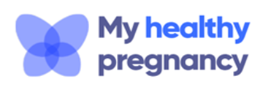
Adult Weight Management service
Delivered by TBC healthcare
A 14- week group, based lifestyle programme combining nutrition, physical activity and behaviour change.
Led by health advisors with weekly weight check ins offered in person or via MS Teams.
Follow up support available for up to a year with access to an e learning platform and digital portal.
Designed for individuals with higher BMIs and comorbidities delivered by psychologist, dieticians and exercise specialists
Initial 12-week intensive phase followed by 9-month maintenance phase focused on psychological led behaviour change and emotional eating triggers.
Designed for women preconception, during pregnancy and post nataly to promote healthy weight
Includes guidance from a specialist maternity dietician and weekly healthy lifestyle support from a pregnancy health advisor.
Eligibility
Adults aged 18 years and above
Live in Hertfordshire and/or registered with a Hertfordshire GP
Have a BMI ≥30 OR BMI ≥27.5 for ethnic minority communities
and those with associated co-morbidities
Referrals
Self referrals can be made by visiting www.tbchealthcare.co.uk or calling 01707 242188
Healthcare professionals can use the form on DXS or Ardens and all other professionals can email hertfordshire@tbchealthcare.co.uk or call 01707 242188

Slide 14
My Baby’s Brain Training : Autum courses available
💻 Delivered via Zoom
Free online training for professionals working with families and children aged 0–3
Help build strong foundations for babies’ development by understanding how early relationships and everyday interactions shape the brain.
My Baby’s Brain Training Universal
For: Professionals offering universal early years support (e.g. Health Visitors, Midwives, Family Centre staff)
To Learn:
· Introduction to the Five to Thrive model
· Understanding trauma and how everyday interactions support recovery
Dates:
· 📅 Thursday 18 Sept 2025, 9:30am–3:00pm
· 📅 Wednesday 22 Oct 2025, 9:30am–3:00pm
Book here: KCA: Reg form: My Baby's Brain Autumn 2025 - Universal Services Workforce
My Baby’s Brain Training Targeted
For: Professionals supporting vulnerable families (e.g. Family Safeguarding, Specialist Services, specialist midwifery)
To learn:
The importance of attachment and how early adversity can lead to developmental trauma
Introduction to the Five to Thrive model for promoting secure relationships
The impact of trauma and principles of trauma-informed practice
Opportunities for reflection on practitioner vulnerability when working with traumatised individuals
Dates:
· 📅 Thursday 2 Oct 2025, 9:30am–3:00pm
· 📅 Wednesday 12 Nov 2025, 9:30am–3:00pm
Book here: KCA: Reg form: My Baby's Brain Autumn 2025 - Targeted Services Workforce

Slide 15

Parenting Courses
Targeted parenting courses are commissioned by Strategic Partnerships Commissioning team, within the Joint Children’s and Young People Commissioning Service and through the Targeted Parenting Framework (TPF).
They will meet the most common parenting needs in Hertfordshire and will be a key contributor to the overall package of support that a parent receives. Parenting courses to be delivered as part of a wider package of intervention and not in isolation.
Six providers have been commissioned through the Strategic Partnerships Commissioning team :-
ADD-vance
Families in Focus
Family Lives
Families feeling safe
SPACE
Supporting links.
There is NO cost for families to attend.
Further information about workshops can be found on The SEND Local Offer and
Parenting directory .

Slide 16


Relationship Support
The Strategic Partnerships Commissioning team have developed a webpage full of resources to support parents in conflict and a range of digital and group based courses:
Stronger Relationships: A 6-week group based course for co-parents living together or apart that focuses on managing stress and enhancing communication.
Parenting When Separated: A 6-week group based course for separated parents that focuses on the emotional impact of separation and supporting communication between co-parents.
Co-Parenting with Care: A 6-week group-based online course for parents and carers of neurodiverse children seeking guidance, support, and strategies for co-parenting more consistently.
OnePlusOne’s digital interventions: 3 online courses aimed at new parents, intact parents and parents that are separated:
Arguing Better
Me, You and Baby Too
Getting it right for children
Relationship support details
If you would like to know more about the training, resources and courses available to support parental relationships please contact CSStrategic.PartnershipsCommissioning@hertfordshire.gov.uk.

Slide 17
Key Families First Links
Keep up-to-date by reading o latest Families First: Families First News
Link to support for families:- Families First Website
Professionals area:-Early Help – information for professionals and partners
For Families First partnership groups, news sharing and general info email:- familiesfirst.support@hertfordshire.gov.uk
Ensure your service is listed on the Hertfordshire Directory:- Register to add a listing | Hertfordshire Directory

