Slide 1
HSCP/HSAB L&D
PROGRAMME
May 2021
All our training courses are now via a live webinar, using MS Teams
(Guidance/advice on using MS Teams)
Join us for live webinars and learn about the latest safeguarding practice.
Booking Conditions
Index of Training Offer
Click on course name for further details and booking
Digital Offer
HSCP E-Learning Offer
Children
JOINT HSCP/NSPCC NEGLECT CAMPAIGN – FREE Neglect Awareness Sessions
Emotional Wellbeing/Spot the Signs -Children and Young People
Working with Mothers with Emotionally Unstable Personality Disorder (EUPD)
Graded Care Profile – a tool to be used when on-going Neglect is a concern
Motivational Interviewing
Understanding and Identifying Neglect with a focus on Early Help
Safeguarding and Child Protection Multi Agency Course
Child Sexual Exploitation Prevention, Protection & Investigation
Physical Abuse in Children (previously the ‘Bruising Lite Bite’)
Child Protection Conference Training
Disguised Compliance & Avoidant Families
Safeguarding Vulnerable Groups
The Toxic Trio
Adults
SPOT THE SIGNS Suicide Prevention Training for Adult Practitioners
HSAB Multi-Agency Safeguarding Adults Awareness
HSAB Safeguarding Forum Cybercrime, Scams and Fraud
HSAB Training Offer for Practitioners Working with ADULTS – Forthcoming Events
Joint Children and Adults
The Science of Wellbeing
Friends Against Scams – free online video and training
For bookings, please visit the HSCP website

Slide 2
HSCP/HSAB L&D
PROGRAMME
JOINT HSCP AND NSPCC NEGLECT CAMPAIGN
As part of the Neglect Campaign we are offering FREE sessions on
BASIC NEGLECT AWARENESS
(45 to 60mins)
Open to all workers (professional and non-professional) who work in settings with Children and Young People FREE of charge
Facilitated by the NSPCC and local Partner Agencies
Each session is aimed at specific groups, as follows:
Agency Group | Date
Housing | 26 April, 12noon
PCSOs | 27 April, 12:30pm
Ambulance | 4 May, 12:30pm
Fire & Rescue | 5 May, 12:30pm
Dentists/Dental Workers | 6 May, 1pm
Primary and Special Schools | 10 May, 4pm
Secondary and Special Schools | 12 May, 4pm
Community Youth Football Groups | 12 May, 10am
Voluntary Sector | 19 May, 2pm
Library Staff | 24 May, 10am
Faith Groups | 24 May, 11:30am
For bookings, please visit the HSCP website

Slide 3
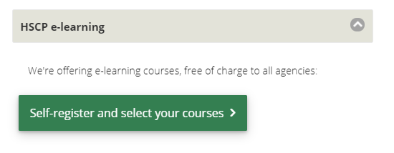
HSCP/HSAB L&D
PROGRAMME
THE HSCP E-LEARNING OFFER
We are now offering four e-learning courses
FREE OF ALL AGENCIES IN HERTFORDSHIRE
Gypsy & Traveller Cultural Awareness
Child Sexual Exploitation
Gangs and Youth Violence
Sexual Abuse and Recognising Grooming
Please visit our website to self-register and select a course
For bookings, please visit the HSCP website

Slide 4

HSCP/HSAB L&D
PROGRAMME
The Science of Wellbeing
Wellbeing Courses
Open to both Children and Adult practitioners
2hr sessions
Facilitator: Adrian Bethune
How the science of wellbeing can improve your life
In this session, wellbeing expert Adrian Bethune, will introduce attendees to the science of wellbeing (sometimes known as positive psychology), sharing the evidence of what works and giving practical ideas for applying it to their lives. It will cover rewiring the negativity bias, maintaining perspective, mindfulness, generating positive emotions and gratitude.
Bio:
Adrian Bethune is a part-time primary school teacher, the Education Policy co-lead at the Mindfulness Initiative and founder of Teachappy. In 2012, he was awarded a ‘Happy Hero’ medal by Lord Richard Layard at the House of Lords for his work on developing wellbeing in schools. In 2015, he was invited to speak at the Action For Happiness event, Creating A Happier World, on stage with the Dalai Lama. Adrian is author of the award-winning Wellbeing In The Primary Classroom – A Practical Guide To Teaching Happiness (Bloomsbury, 2018) and co-author with Dr Emma Kell of A Little Guide to Teacher Wellbeing and Self-care (Sage, 2020) .
Date | Availability
7 May 2021 (9am to 11am) | Places available
You can log onto the HSCP or HSAB booking systems and add your name to our waiting lists for any courses
For bookings, please visit the HSCP website

Slide 5
HSCP/HSAB L&D
PROGRAMME
EMOTIONAL WELLBEING/SPOT THE SIGNS
Children and Young People
The HSCP are offering the following training sessions, facilitated by Herts Mind Network.
Introduction to Mental Health
Audience: all practitioners working with children and young people in Hertfordshire (age groups primary Years 5 & 6, secondary schools and colleges).
Emotional Wellbeing and Coping Strategies
Audience: all practitioners working with children and young people in Hertfordshire.
Adolescent Development
Audience: all practitioners working with children and young people in Hertfordshire.
Spot the Signs (Youth Suicide Prevent Course)
Audience: all practitioners working with children and young people (aged 9yrs to 20yrs) in Hertfordshire.
Dates and times below
Date | Availability
Introduction to Mental Health 17 May 2021 (2pm to 3:30pm) 24 May 2021 (10am to 11:30am) | Places available Places available
Emotional Wellbeing and Coping Strategies 17 May 2021 (10am to 11:30am) | Places available
Adolescent Development 24 May 2021 (2pm to 3:30pm) | Places available
Spot the Signs (Youth Suicide Prevent Course) 10 May 2021 (10am to 2:30pm) 20 May 2021 (10am to 2:30pm) | Places available Places available
For bookings, please visit the HSCP website

Slide 6
HSCP/HSAB L&D
PROGRAMME
SPOT THE SIGNS Suicide Prevention Training for Practitioners working with ADULTS
The HSAB are offering the following training sessions, facilitated by Herts Mind Network.
Audience: all practitioners working with adults
Aim of sessions:
Increase your awareness and knowledge of suicide
Introduce practical steps about how to respond to someone who may be at risk of suicide
Highlight the misconceptions and stigma surrounding suicide
Date | Availability
24 May 2021, 9:30am to 12:30pm | FULLY BOOKED
26 May 021, 9:30am to 12:30pm | FULLY BOOKED
27 May 2021, 9:30am to 12:30pm | Places available
For bookings, please visit the HSCP website

Slide 7
HSCP/HSAB L&D
PROGRAMME
HSAB Multi-Agency Safeguarding ADULTS Awareness
Held over two 1.5hr sessions starting at 9:45am and finishing at 2.45pm, via MS Teams (equivalent to a one day training session)
Target audience: This training course is suitable for Safeguarding leads/Champions within an organisation and anyone working with adults, who wants to increase their understanding of safeguarding adults.
Attendance criteria: An awareness raising multi-agency training session developed for practitioners across Hertfordshire with a responsibility for safeguarding adults at risk.
Learning Outcomes:
To develop or refresh awareness of what to do when we suspect or know an adult is being abused;
To recognise the different kinds of abuse, signs and symptoms identified in safeguarding adults guidance, including emerging issues such as self neglect, exploitation and modern slavery;
To have an understanding of legislation and national and local guidance related to safeguarding adults, with reference to the duties identified in the Care Act 2014 and Making Safeguarding Personal;
To consider recent developments in learning arising from local and national safeguarding adults reviews;
To understand the processes of assessment, planning and review for adults at risk and your agency’s possible involvement;
To recognise the importance of working together in a multiagency approach.
Date | Availability
22 June 2021 | Places available
14 October 2021 | Places available
29 January 2022 | Places available
You can log onto the HSCP or HSAB booking systems and add your name to our waiting lists for any courses
For bookings, please visit the HSCP website

Slide 8
HSCP/HSAB L&D
PROGRAMME
HSAB Training Offer for Practitioners Working with ADULTS
HSAB SAFEGUARDING FORUM - Cybercrime, Scams and Fraud
8 June and 30 June 2021
10am-12pm
Presentations by Hertfordshire Constabulary and Hertfordshire Trading Standards
Doorstep criminals and telephone fraudsters have always targeted our most vulnerable residents and continue to do so. However, with the world becoming more virtually connected, online crime, scams and fraud are on the rise. Criminals are more creative in ways they target people and make them part with their money.
Join us on one of the forums to learn more about spotting the signs, reporting and supporting people who are victims.
Audience: All practitioners working with adults
For bookings, please visit the HSCP website

Slide 9
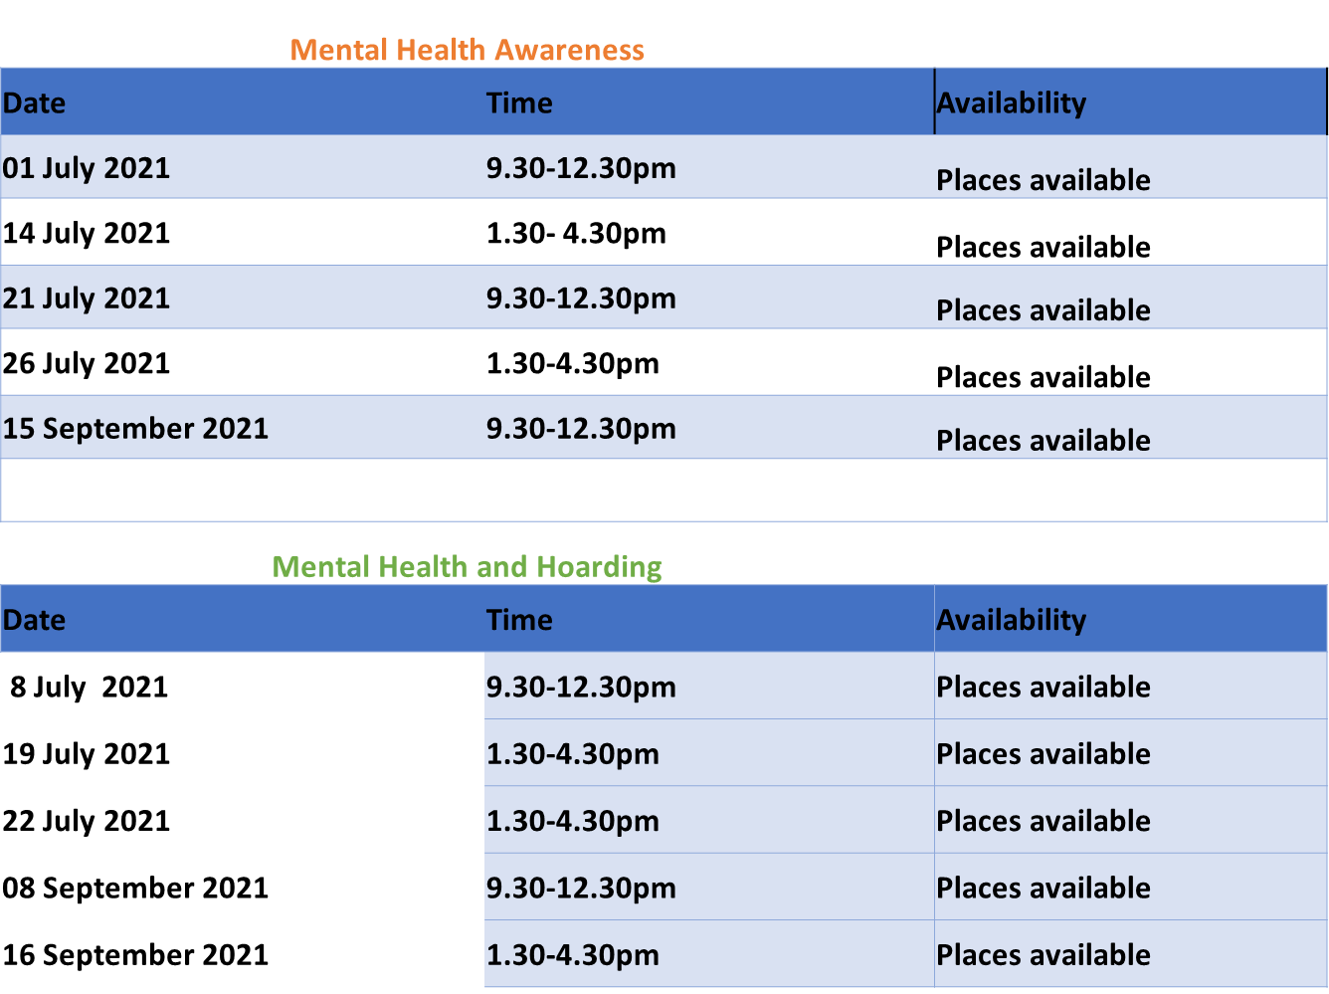
HSCP/HSAB L&D
PROGRAMME
HSAB Training Offer for Practitioners Working with ADULTS
Save the date:
Hoarding and Mental Health
Mental Health Awareness
To be delivered in July and September in partnership with Herts Mind.
You can log onto the HSCP or HSAB booking systems and add your name to our waiting lists for any courses
For bookings, please visit the HSCP website

Slide 10
HSCP/HSAB L&D
PROGRAMME
Working with Mothers with Emotionally Unstable Personality Disorder (EUPD)
Delivered by:
The HPFT Community Perinatal Team:
Dr Sarah Cohen, Consultant Perinatal Psychiatrist
Dr Shetal Patel, Clinical Perinatal Psychologist
Dr Natasha Gray, Parent-Infant Psychologist.
Held over a 2.5hr session (with a 10min break) starting at 9:30am, via MS Teams (equivalent to a half day training session)
Target audience:
Non-mental health professionals who work with pregnant women and mothers who have Emotionally Unstable Personality Disorder, e.g. but not limited to Children's services practitioners; midwives and health visitors:
Content:
This course is to support staff who are working with families where parents (particularly the mother) has Emotionally Unstable Personality Disorder (EUPD). To include:
Why EUPD develops; how it manifests and the impact of EUPD on the family in the perinatal period.
Risks that EUPD poses and risk assessment
Advice on working with mothers with EUPD to reduce risks
Understanding and supporting the parent infant relationship when a parent has EUPD
Date | Availability
14 September 2021 9:30am | FULLY BOOKED
10 November 2021 9:30am | FULLY BOOKED
You can log onto the HSCP or HSAB booking systems and add your name to our waiting lists for any courses
For bookings, please visit the HSCP website

Slide 11
HSCP/HSAB L&D
PROGRAMME
Graded Care Profile – a tool to be used when on-going Neglect is a concern
Held over a 3hr session (with a comfort break) starting at 10am, via MS Teams (equivalent to a half day training session)
Target audience: appropriate for any professionals working directly with children and their families within the home or other settings (social workers, health visitors, school nurses, community nursery nurses, specialist children’s nurses, children centre workers, schools).
Aim of the Course: Understand the evidence based research behind the development of and use of the Graded Care Profile (GCP) tool kit, introduce the GCP tool kit, develop the skills to use the tool kit, understand the scoring system, consider how a GCP assessment is used in future service and support development for the children and their families.
Attendance Criteria: Basic/Stage 1 Safeguarding Children training should have been undertaken prior to accessing this training.
Learning Outcomes:
There will be a better understanding of the GCP tool and how to use it
Have an understanding how to adapt the way the GCP is used in regards to a family’s needs/ability to participate
Have a better understanding of how to complete the tool kit using multi-agency input
The candidate will complete a GCP, the scoring and compile a future action plan to work with the family to reduce the risks/concerns
The candidate will have a better understanding of when to step up their concerns using the GCP as additional evidence.
*PRE-COURSE WORK*
Please see the 'Download Course Materials' link on your training account dashboard where, under the 'Pre-course' section, you will be able to access the pre-reading material for the training session and copies of all the documents necessary for the session.
Please note – It is very important that the pre-course reading is undertaken by all delegates prior to attending the training as it will inform the most important parts of the session.
Date | Availability
15 June 2021 10am | FULLY BOOKED
16 September 2021 10am | Places available
5 November 2021 10am | Places available
11 January 2022 10am | Places available
16 March 2022 10am | Places available
For bookings, please visit the HSCP website

Slide 12
HSCP/HSAB L&D
PROGRAMME
Motivational Interviewing
Trainers: Alasdair Cant & Associates
Pre-reading:
Introduction to Motivational Interviewing
Held over a 2.5hr session (with a comfort break), via Zoom (equivalent to a half day training session) – see below for start times
Target audience: Practitioners from all agencies working with children, young people and their families
Aim: To gain an overview of a motivational skills approach
Objectives:
To gain a practical understanding of Motivational Interviewing as a strengths-based approach
To understand the cycle of behaviour change, and how it can help make conversations more productive
To explore situations where there is resistance and ambivalence to change
Date | Availability
20 May 2021 13:30 – 16:00 | FULLY BOOKED
22 Sept 2021 09:30 – 12:00 | FULLY BOOKED
15 Nov 2021 13:30 – 16:00 | FULLY BOOKED
You can log onto the HSCP or HSAB booking systems and add your name to our waiting lists for any courses
For bookings, please visit the HSCP website

Slide 13
HSCP/HSAB L&D
PROGRAMME
Understanding and Identifying Neglect with a focus on Early Help
Held over a 2hr session, with a short comfort break. Start time 10am.
Target audience: Any professional working with children and their families
Attendance criteria: Participants will have already attended child protection awareness training and have an understanding of the signs and symptoms of child abuse.
Aim of the Course: To provide professionals with a greater understanding of the concept of neglect and what current research tells us in relation to the abuse of children.
Learning Outcomes:
By the end of the course, participants will to able to:
establish a working definition of neglect
recognise signs and symptoms in children and young people who are suffering, or may be suffering, neglect
explore the impact of neglect on child development
make use of research and findings from Serious Case Reviews to inform practice
gain understanding of the importance of a multi-agency approach to neglect
Date | Time
6 May 2021 | FULLY BOOKED
15 September 2021 | Place available
8 December 2021 | Places available
22 March 2022 | Places available
For bookings, please visit the HSCP website

Slide 14
HSCP/HSAB L&D
PROGRAMME
Safeguarding and Child Protection Multi Agency Course
Held over two 1.5hr sessions starting at 9:45am and finishing at 2.45pm, via MS Teams (equivalent to a one day training session)
Target audience: Any professional working with children and their families
Attendance criteria: Delegates must have completed Level 1 Safeguarding/Child Protection training within their own agency.
Learning Outcomes:
By the end of the course, participants will:
gain knowledge of what to do when participants suspect that a child is suffering abuse;
be aware of the locally agreed procedures and the expectations of the participant’s role in safeguarding and promoting the welfare of children and the importance of working together to achieve this;
have an understanding of key relevant legislation and statutory guidance in this area;
consider the needs of the child across the continuum of care, from early help to child protection utilising the local thresholds document;
refresh their practitioner knowledge of the key categories of harm and how these might be identified;
look at what happens after the concern has been raised and acknowledged; and
look beyond the referral at how concerns are addressed including the child protection conference process.
Date | Availability
18 May 2021 | FULLY BOOKED
29 June 2021 | FULLY BOOKED
14 July 2021 | Places available
7 Sept 2021 | Places available
5 Oct 2021 | Places available
For bookings, please visit the HSCP website
You can log onto the HSCP or HSAB booking systems and add your name to our waiting lists for any courses

Slide 15
HSCP/HSAB L&D
PROGRAMME
Child Sexual Exploitation Prevention, Protection & Investigation
Held over a 1.5hr session starting at 9:30am, via MS Teams (equivalent to a half day training session)
Target audience: Practitioners from all agencies working with children, young people and their families
Aim of the Course: To raise awareness of child sexual exploitation including typical indicators, grooming models, impact, responding to concerns, communication and engagement with young people, good practice guidance.
Learning Outcomes:
What Child Sexual Exploitation means
How to identify the vulnerability and risk factors of children/young people who are at risk of CSE and the reasons why they may become involved in, or targeted for, CSE
The impact of CSE on a child/young person
How to respond to concerns and share information, including making referrals to appropriate services in order to both protect and support the child/young person
Date | Availability
19 May 2021 | FULLY BOOKED
14 October 2021 | Places available
18 November 2021 | Places available
24 March 2022 | Places available
NEW DATES ADDED FOR 2021/22
For bookings, please visit the HSCP website

Slide 16
HSCP/HSAB L&D
PROGRAMME
Physical Abuse in Children (previously the ‘Bruising Lite Bite’)
Held over a 2hr session starting at 10am, via MS Teams (equivalent to a half day training session)
Target audience: Health Visitors, School Nurses, Social workers, Assistant Team Managers, Team Managers, Nursery Nurses, Child Care Workers, Children Centre Staff, Teachers, Police Officers, CAIU, Youth workers, Allied Health professionals, GPs
Aim of the Course: To enable the multi-agency team to recognise and respond to physical abuse in children
Pre-course Work: Please see the 'Download Course Materials' link from our training website, under the 'Pre-course' section, you will be able to access all the pre-reading materials and download the preparation worksheet.
Please note – The documents for download are useful reading and tools for you and we recommend that you read these as part of your forward learning around Physical abuse in children.
There are also tools to help you with reflection of your own practice.
Please also download ‘Assessment of marks in babies under 6 months’
Learning Outcomes:
To embed the practice of using the HSCP pathways for physical abuse
To raise awareness of Serious Case Reviews involving physical abuse of children
To broaden knowledge around assessment of bruising in small children
To enable professionals to effectively respond and refer for children where physical abuse is suspected
Date | Availability
15 June 2021 | Places available
15 September 2021 | Places available
9 November 2021 | Places available
For bookings, please visit the HSCP website

Slide 17
HSCP/HSAB L&D
PROGRAMME
Child Protection Conference Training
Held over a 1hr 45min session , via MS Teams (equivalent to a half day training session)
Target audience: Health Services (GPs, health visitors, midwives, school nurses), School staff, Early Help staff, Probation, Children’s Services staff (domestic abuse practitioners, mental health practitioners), Community Adolescent Mental Health Service, Community Mental Health Team, Adult services, Children’s Centre staff.
Attendance Criteria: Delegates must have completed mandatory Basic/Stage 1 Safeguarding/Child Protection training within their own agency.
Aim of the Course: To learn about the structure and processes associated with a Child Protection conference and the methods and responsibilities of those involved.
Learning Outcomes:
Information on the conference style and structure
Children’s views
What is expected of you – your role and responsibilities
The role of the Child Protection Conference Chair
Reports to conferences – how to write them, where to send them and what should be included.
Timescales.
Decision making process.
Outcomes of a plan, process of monitoring progresses
Differences between Child in Need and Child Protection
Child protection process beyond the conference
Date | Availability
11 June 2021 – 10am | Places available
9 Sept 2021 – 1pm | Places available
17 November – 10am | Places available
18 January 2022 – 1pm | Places available
For bookings, please visit the HSCP website

Slide 18
HSCP/HSAB L&D
PROGRAMME
Disguised Compliance & Avoidant Families
Held over a 2hr 15min session, via MS Teams (equivalent to a half day training session)
Trainer Professor Brian Littlechild
Target audience: Practitioners from all agencies working with children, young people and their families
Aim of the Course: This is a multi-agency course giving practitioners the opportunity to recognise, deal with, and at times challenge, the behaviours of resistance and avoidance tactics employed by potentially aggressive parents.
Pre-course Work: Please see the 'Download Course Materials’ on our training website where, under the 'Pre-course' section, you will be able to access the schedule for the training session, a copy of the Disguised Compliance Top Tips booklet and a pre-course worksheet.
Please note – It is very important that the pre-course work is completed fully by all delegates prior to attending the training as it will form the basis for the first part of the session.
Learning Outcomes:
To improve the confidence and skills of professionals dealing with issues of disguised compliance.
Offer challenge and peer support to staff no matter what level in order to facilitate discussions with families exhibiting possible disguised compliance tactics.
To increase knowledge, skills and competence of staff to recognise the signs and respond appropriately when working with avoidant families.
To meet a locally identified need by service providers and commissioners.
Date | Availability
13 May 2021 9:30am | FULLY BOOKED
16 September 2021 9:30am | FULLY BOOKED
18 February 2022 9:30am | Places available
For bookings, please visit the HSCP website

Slide 19
HSCP/HSAB L&D
PROGRAMME
Safeguarding Vulnerable Groups
Held over two 1.5hr sessions starting at 9:45am and finishing at 2.45pm, via MS Teams (equivalent to a one day training session)
Target audience: Practitioners from all agencies working with children, young people and their families
Aim of the Course: This is a multi-agency course giving practitioners from a range of agencies the opportunity to consider and discuss safeguarding issues that arise for vulnerable children and young people.
Learning Outcomes:
to be able to recognise the categories of abuse and the impact that abuse has on vulnerable children and young people, including a particular focus on neglect and early help
to increase knowledge regarding the prevalence of the abuse of vulnerable children and young people
to raise awareness of the issues particular to working with children who have a disability
to understand the responses required from professionals and others involved with vulnerable children and young people in order to adequately protect them
to consider some of the barriers to detection and disclosure of the abuse of children and young people with disabilities
to consider the findings of recent reviews, both locally and nationally, as well as key legislation and guidance and how this impacts on practice
Date | Availability
8 June 2021 2021 | FULLY BOOKED
13 October 2021 | FULLY BOOKED
10 November 2021 | Places available
For bookings, please visit the HSCP website

Slide 20
HSCP/HSAB L&D
PROGRAMME
The Toxic Trio
Two 3hr sessions available; one starting at 10am and the second starting at 13:30pm, via MS Teams (equivalent to a half day training session)
Target audience: Practitioners from all agencies working with Families and Young People
Aim of the Course: To raise awareness of the impact that Parental Mental Health, Parental Substance Misuse and Domestic Abuse has on children and young people.
Learning Outcomes:
improve the knowledge, skills and working practices to better identify substance misuse, mental health and domestic abuse and the risks to children and the roles and responsibilities of agencies.
explore the impact of substance misuse, mental health and domestic abuse on families and parenting from the perspective of the children.
review and identify the signs associated with substance misuse, domestic abuse and mental health in parents and their extended families.
provide harm reduction advice
Date | Availability
19 October 2021 9:30am | FULLY BOOKED
19 October 2021 1:30pm | Places available
17 March 2022 9:30am | Places available
17 March 2022 1:30pm | Places available
You can log onto the HSCP or HSAB booking systems and add your name to our waiting lists for any courses
For bookings, please visit the HSCP website

Slide 21

HSCP/HSAB L&D
PROGRAMME
Friends Against Scams
The HSCP/HSAB are supporting the
National Trading Standards Scams Team
Friends Against Scams is designed to inspire action, highlight the scale of the problem, change the perceptions of why people fall for scams and make scams a community, regional and national topic.
By completing the online learning Friends Against Scams awareness session, anyone can learn about the different types of scams and how to spot and support a victim. With increased knowledge and awareness, people can make scams part of everyday conversation with their family, friends and neighbours, which will enable them to protect themselves and others.
TOGETHER WE CAN TAKE A STAND AGAINST SCAMS
Please access the Friends Against Scams website and view their video and to complete their FREE online training.

Slide 22
HSCP/HSAB L&D
PROGRAMME
Booking
Conditions
HSCP training courses and charges
Our training courses build on the level 1 awareness sessions provided by agencies to their own staff.
Our programme includes full day and lite sessions. However, during the Covid-19 period we are offering limited live webinar sessions, via MS Teams.
All learning events are run by knowledgeable trainers and experts in the field, so you can be sure that the content will be interesting, stimulating and reflects safeguarding best practice in Hertfordshire.
Course Charges
There is a charge for all delegates from agencies that do not contribute to the HSCP or HSAB budget, including schools, district and borough councils, out of county providers and profit making private and independent organisations.
The charge for a full-day course is £75.00 per person
The charge for a half-day course is £50.00 per person
The charge for a Lite Bite sessions is £30 per person
Courses are free of charge to HSCP and HSAB contributory member agencies and the voluntary sector.
Cancellation Charges
Cancellation charges apply to everyone including those who fall into the free of charge payment category. Charges are as follows:
£75 per person per full-day course
£50 per person per half-day course
£30 per person per Lite Bite session
Cancellation charges applied if delegates fail to attend on the day or fail to attend on the day or fail to cancel in writing at least 14days in advance of the course.
MS Teams
Guidance
Please note, you don’t need to have Office 365 products (MS Teams) on your tech (PC, laptop, tablet or smartphone) to join as a guest, as long as you have a good broadband connection, a microphone and a web browser. (You do not necessarily need a webcam for this session).

Slide 23

HSCP/HSAB L&D
PROGRAMME
MOTIVATIONAL INTERVIEWING
‘You lot don’t care! You’re going to take our kids away and you get a bonus for that’
‘Why aren’t you going to the neighbours down the road, they’re much worse than us!’
‘What do you know? Do you have kids of your own?’
Are these kinds of ‘heart-sink’ phrases familiar? Do you or your staff frequently find themselves on the defensive as practitioners or as managers? In an environment of diminishing resources and increasing demand on services, we need a fresh and imaginative approach.
Motivational Interviewing is a framework of intervention, brought together in the 1990s by William Miller and Stephen Rollnick. It is an approach that is designed to work with those most resistant to change or stuck in entrenched behaviours. The premise of Motivational Interviewing is that motivation is not a ‘fixed state’ that a person does, or does not have. Rather, motivation ebbs and flows depending on many factors such as circumstances, mood and so forth. The skilled practitioner (or manager) will harness whatever very little motivation there might be, and help it move in the right direction. The Motivational Interviewing approach borrows in from other sources such as Carl Rogers’ person-centred counselling; Socratic thinking and Prochaska & DiClemente’s Cycle of Behaviour change.
The key principles are:
Engagement with the client, rather than doing something to them – i.e. change cannot be forced or pushed on to someone. It has to be internal for the client to be meaningful and long term.
Rolling with resistance (NB this is not rolling over or being passive)
Express empathy
Avoid conflict
Developing discrepancy in client’s thinking
Support self-responsibility
Clients are often stuck or ambivalent about making changes for themselves. Practitioners can easily collude with this ‘stuckness’, or out of frustration try to push people to action, which only increases resistance. Motivational Interviewing helps to make the practitioner aware of these tendencies, and give them options to work more powerfully in ways that create more possibility of change for their clients.
The half-day interactive webinar will give a practical taster session into Motivational Interviewing, and its potential power to engage with people meaningfully, rather than do something to them. There will be opportunities for demonstration, discussion, and questions, conducted in ways that model the principles of a motivational skills approach. We will explore together how we can all nurture even the smallest steps of progress, with the emphasis on encouragement and trying to bring out the best in others as well as ourselves.
See below for diagram: The Cycle of Change

Slide 24
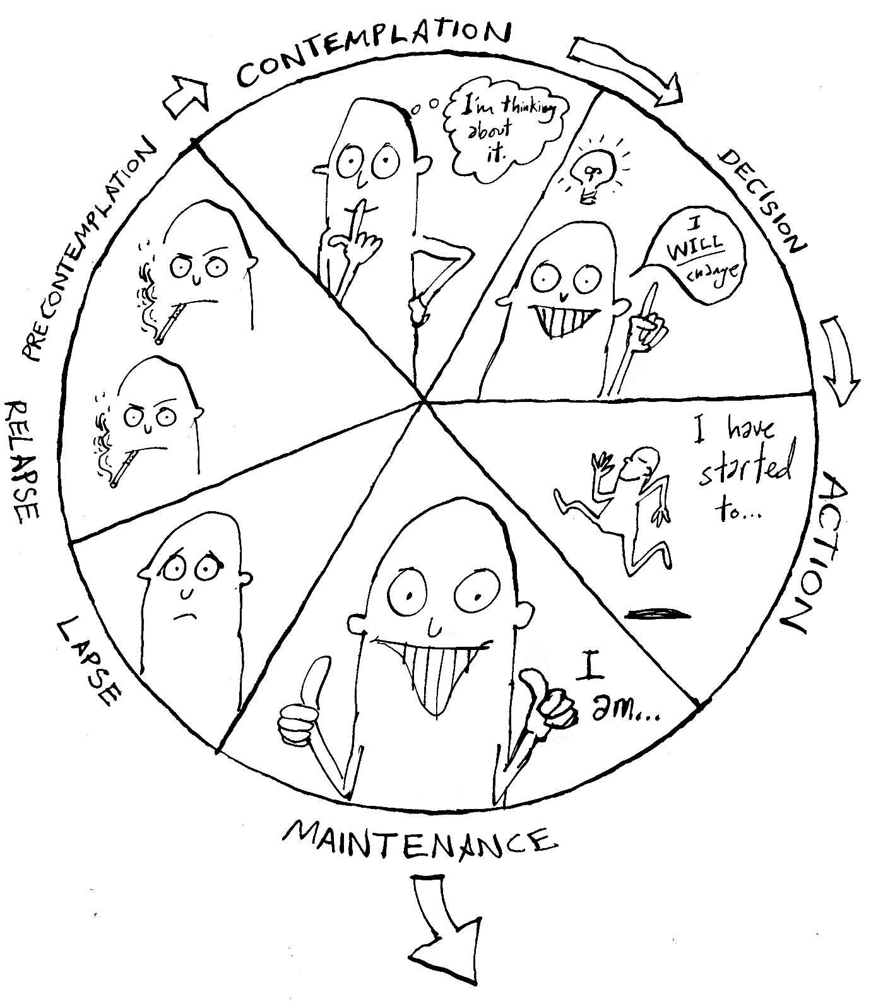

HSCP/HSAB L&D
PROGRAMME
The Cycle of Change

