Slide 1

Safer Sleep:
Lite bite conversations
Michaela Pedgrift – Senior Education Lead, HCT
Jacqui Green – Education Lead, HCT
26th Feb 2025

Slide 2
Introductions
Education Team – Public Health Nursing (PHN) 0-19 for Hertfordshire
PHN skill mix includes, student health visitors, health visitors, band 5 staff nurses, Assistant Public Health Practitioners (APHP) (Nursery Nurses)
Family Centre staff
School & colleges
Notes:
Safer sleep is a key part of our role; advice starts in the antenatal period and we continue discussing sleep safety as infants develop and look at their changing needs.

Slide 3
Aims
Background to recent changes in Hertfordshire to promote safer sleep
Provide guidance on current safer sleep messages including:
  preventing SIDS (Sudden Infant Death Syndrome)
  putting baby to sleep
  home safety
  safety do’s and don’ts
Look at leaflets and resources for parents and professionals
Signpost
Questions and answers
Notes:
(SIDS) is the sudden and unexplained death of an infant where no cause is found after detailed postmortem.

Slide 4
Background
In 2016, there was an 11% rise in cases of SIDS in England and Wales compared with the previous year – highest since 2013.
In 2019, 6 babies under the age of 1 died whilst bedsharing (co-sleeping) with an adult in Hertfordshire.
As a result, Hertfordshire’s Child Death Overview Panel (CDOP) commissioned a project to understand how messages to parents and carers are currently delivered:
  what are the challenges and success factors for effective conversations
  how messages could be reframed in future so that the risks of co-sleeping in particular circumstances are understood and acted upon.
  NICE 2021 – Postnatal Care: based on the evidence and their knowledge and experience, the committee agreed the safe bed sharing practices that should be discussed with all parents and the circumstances in which bed sharing with a baby should be strongly advised against.
Notes:
SIDS deaths per annum
2013 252
2014 217
2015 191
2016 219
2018 213
2019 170
2022 171
Lullaby Trust currently state that 189 babies die each year of SIDS. 91% happens in the first 6 months of life.
In 2023 the Lullaby Trust surveyed 3400 parents and 90% of them said they co-slept with their baby at some point, yet only 40% said they had been given safer co-sleep advice by health professionals. We know this might not have been their intention, in fact the Lullaby Trust survey said that only 9% of parents planned to co-sleep before their baby’s were born but when new parents are exhausted and the baby is not sleeping it is so easy for a parent to take the baby downstairs to give their partner a break and fall asleep on the sofa.
Our practice at the time was to advise all parents that the safest place for their babies to sleep was on their back, in their own cots. We only discussed and advised on co-sleeping where a parent informed us this is what they were doing.

Slide 5
Service Provision – HCT Public Health Nurses
Recommended in Hertfordshire we use nationally resources produced by:
  LULLABY TRUST
  UNICEF
  BASIS
who have collaborated to create a range of resources for parents and health professionals, on safer sleep practices.
Specifically, use Lullaby Trust resources for promoting safer sleep in all settings this includes posters, videos and links to basis for understanding sleep
Offer all families whose first language is not English an interpreter for visits - consider additional signposting to Lullaby Trust or use Lullaby trust videos in language if available
Utilise Health for Under 5s website - it has an automatic translation app installed:
https://healthforunder5s.co.uk/sections/baby/safer-sleeping/ - also links to Lullaby trust
Notes:
Outcome of the project: recommendations were made to improve the consistency and accuracy of the messages regarding safer sleep.
Families where English is not their first language: offer interpreters and consider additional signposting to Lullaby trust - use videos in family language if available
Our own website Health for under 5’s already links directly to Lullaby Trust, and this website has an automatic translation app installed.

Slide 6
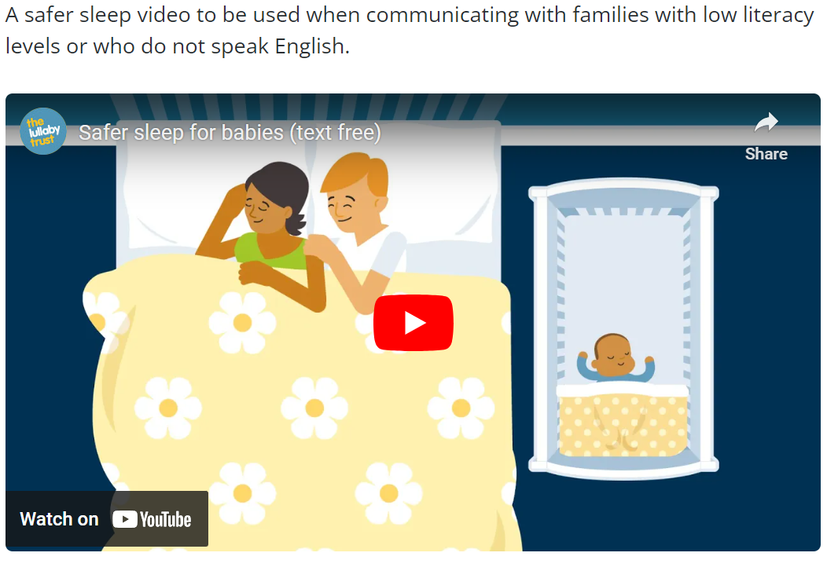
Easy Read Translated
Easy read
https://youtu.be/RZA7_qpF2H0
Lullaby Trust publications - The Lullaby Trust
Notes:
And we just wanted to highlight this particular Lullaby Trust leaflet which is easy to read, lots of pictures. In the right hand box a video that can be used when communicating with families who do not speak English and whose literacy levels are low.
We won’t have time to show you all the videos, we have selected some to watch today but it would be very useful if you had a look on the website for yourselves.

Slide 7
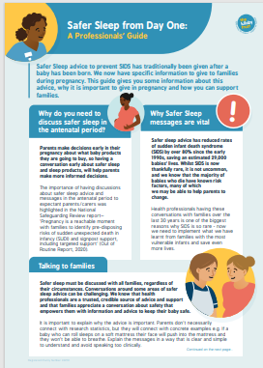
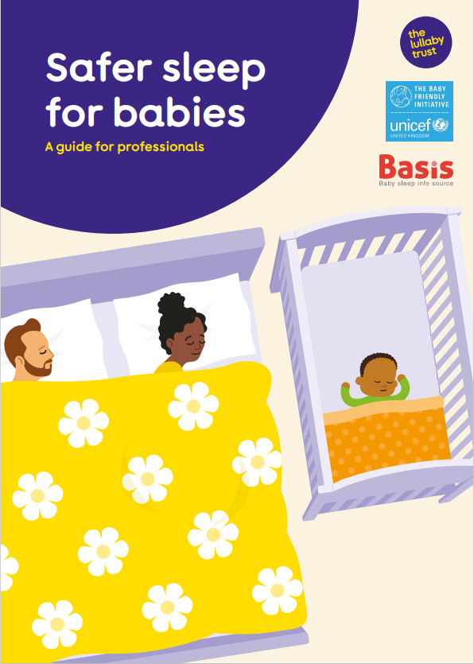
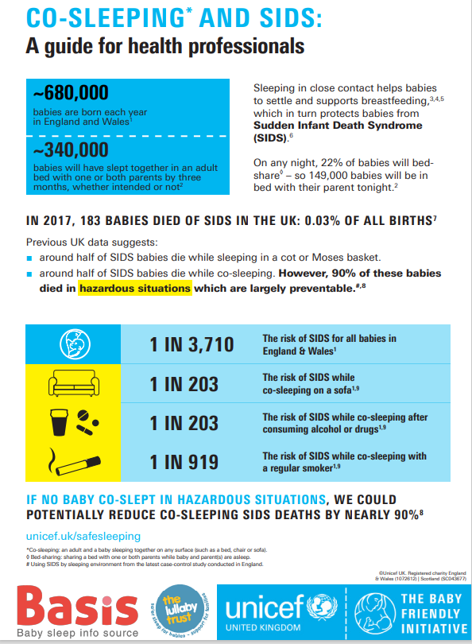

Professional resources – supporting conversations
Lullaby Trust resources, including:
Professionals guide for Safer Sleep messages to expectant parents and following the birth of their baby/babies
Young Parents
UNICEF resources, including:
Co-Sleeping and SIDS: A guide for professionals
‘Having meaningful Conversations with mothers’
Notes:
Another recommendation following the review was about the education of staff – their roles and responsibilities when we deliver safer sleep messages. What are we aiming for? Support parents to make their own decisions? Change behaviour? Only give information?
We aim to see the sleeping environment (which we always have), we want parents to feel they can openly talk about co-sleeping or other sleeping arrangements they have, so we can discuss risks with them and advise how to provide safer sleep for their baby. Maybe they co-sleep out of exhaustion, lack of space……
It should be non-judgemental and conversational. Collaborate with parents to help them make a plan to ensure their baby is as safe as possible.
Whenever we have safer sleep conversations with parents we always signpost to the Lullaby Trust website to reiterate our messages and for additional information.
Another recommendation was about educating our staff roles and responsibilities when we deliver our messages. EG support parents to make their own decisions, change behaviour, only give information.
So what we aim to do is see the sleeping environment, which we always have and we want parents to feel able to open up about co-sleeping so we can discuss how to do it safely. This should be a conversation, we can ask parents why they choose co-sleeping, in a non-judgemental manner – is it exhaustion or choice and then provide all the information regarding the risks, how to do it safely and then help them make a plan if they want to change.
The Lullaby Trust have just last week updated all of their website, their logos are changing and this is what they will look like. The messages are not changing but they want to include more about

Slide 8
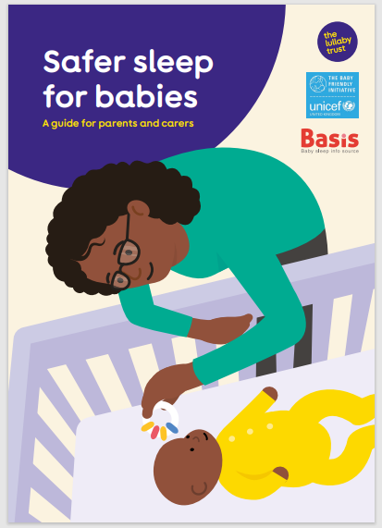
Safer Sleep video and leaflet
Video in other languages
Mandarin https://www.youtube.com/watch?v=XmvNN5KJctA
Farsi
https://www.youtube.com/watch?v=XmvNN5KJctA
Ukrainian https://www.youtube.com/watch?v=FPiyEc0XrpY
Albanian
https://www.youtube.com/watch?v=CsT_i7OgCbA&t=60s
Safer-sleep-for-babies-a-guide-for-parents-web.pdf (lullabytrust.org.uk)
Notes:
This the is a picture of the Lullaby Trust leaflet.
Let’s start by looking at our safer sleep messages in this little video
https://www.youtube.com/watch?v=NO2vbtjNk2c

Slide 9
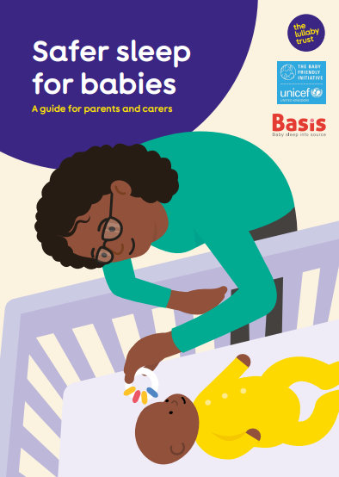
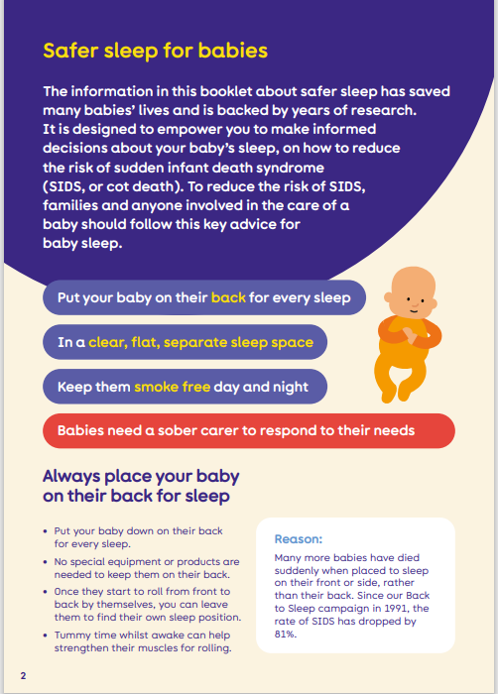
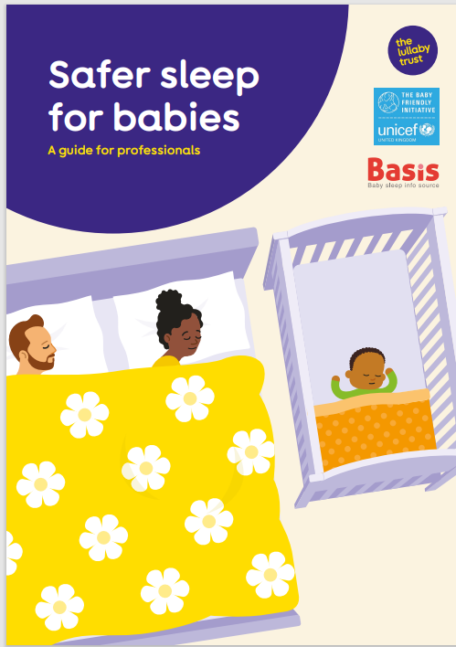
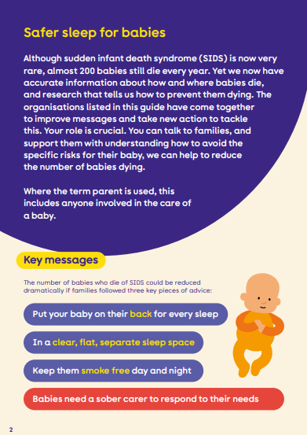
Professional guide leaflet
Parent leaflet
Notes:
As you can see Lullaby Trust match a lot of the resources for parents and professionals. These can help as an aid when having conversations and assessing risk.

Slide 10
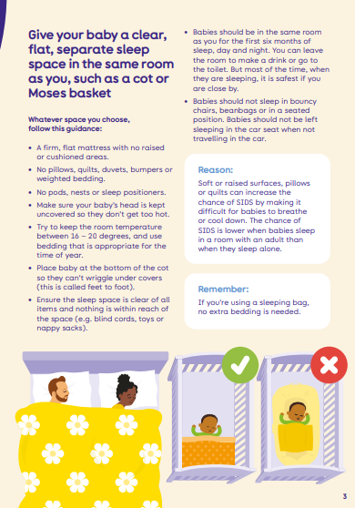
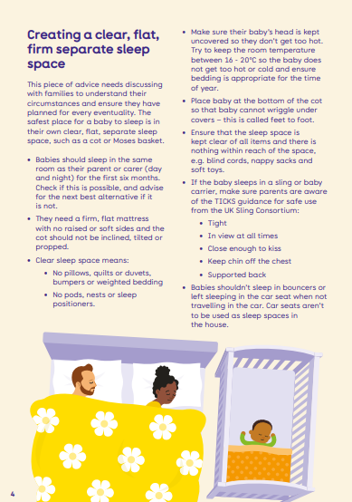
Professional guide
Parent leaflet
Notes:
Additional information
https://youtu.be/cM2RX2SAV4M
https://www.lullabytrust.org.uk/safer-sleep-advice/mattresses-and-bedding/

Slide 11
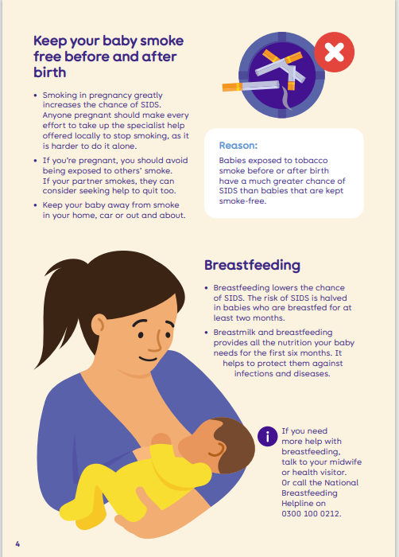
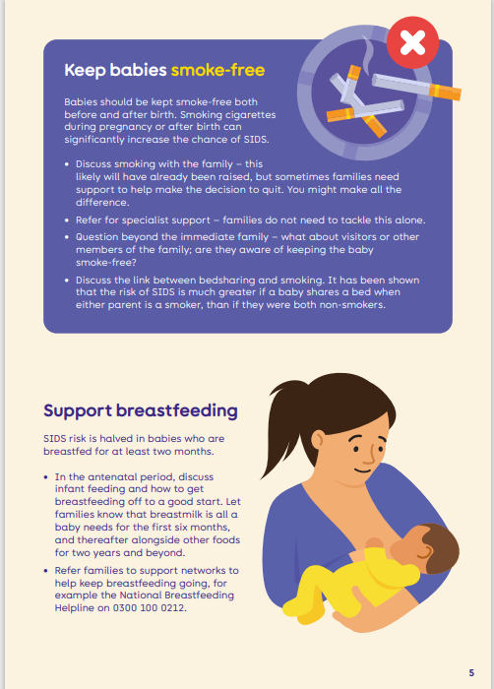
Professional guide
Parent leaflet

Slide 12
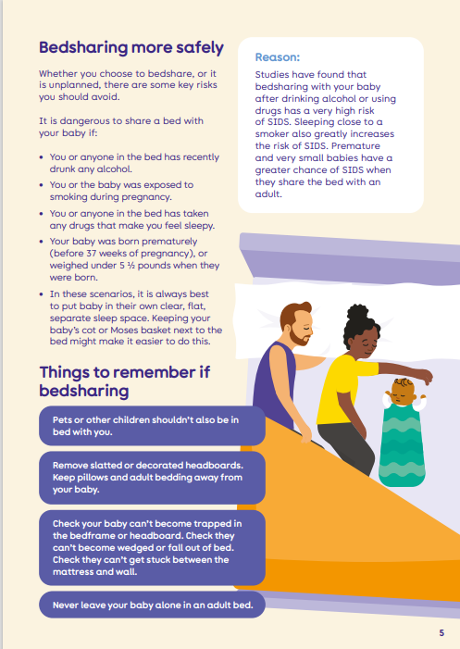
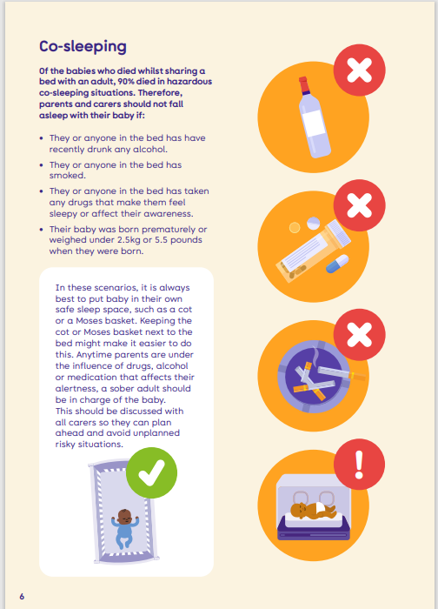
Co-sleep video and leaflet
Professional guide
Parent leaflet
Notes:
These pages are taken from the co-sleeping leaflet.
Let’s watch the co-sleeping video.
https://www.youtube.com/watch?v=suoccf8D1ns

Slide 13
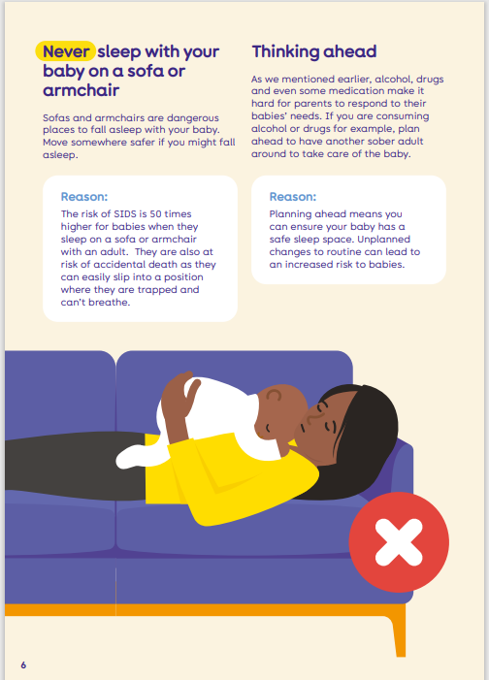
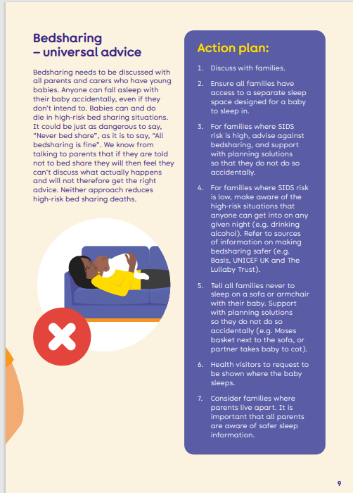
Professional guide
Parent leaflet

Slide 14
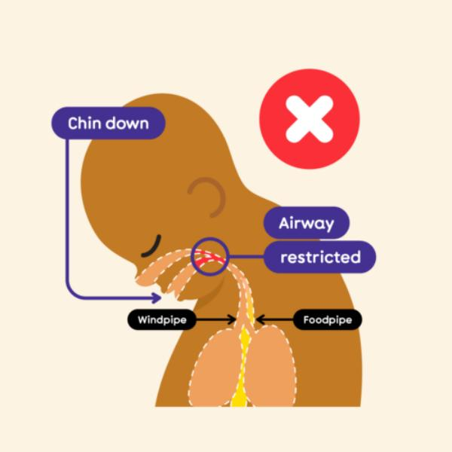
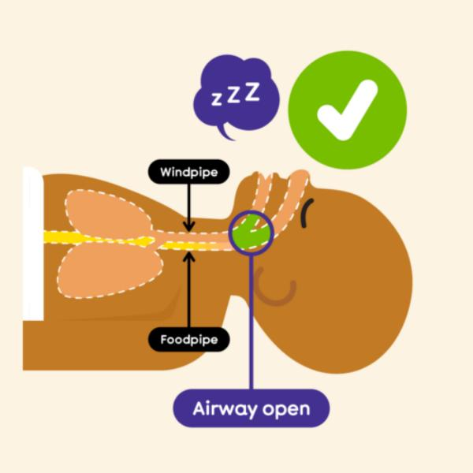
Protect baby’s airway
Notes:
Lullaby Trust have a whole section in their baby hub about protecting baby’s airway – their breathing tube. This is very informative and empowering for parents, it helps them understand why the messages we are providing are so important.
Watch the video:
Baby’s airway | The Lullaby Trust

Slide 15
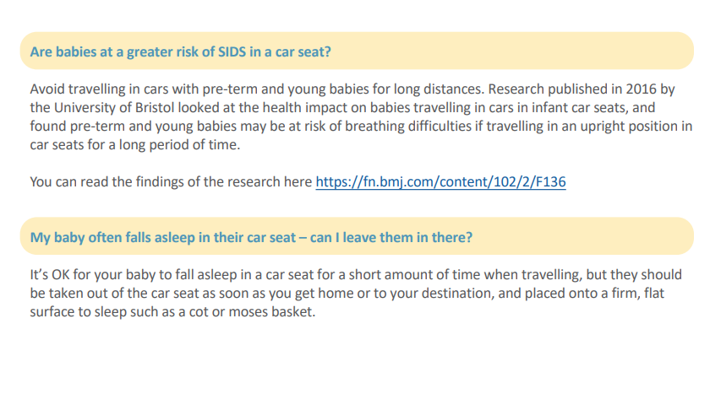
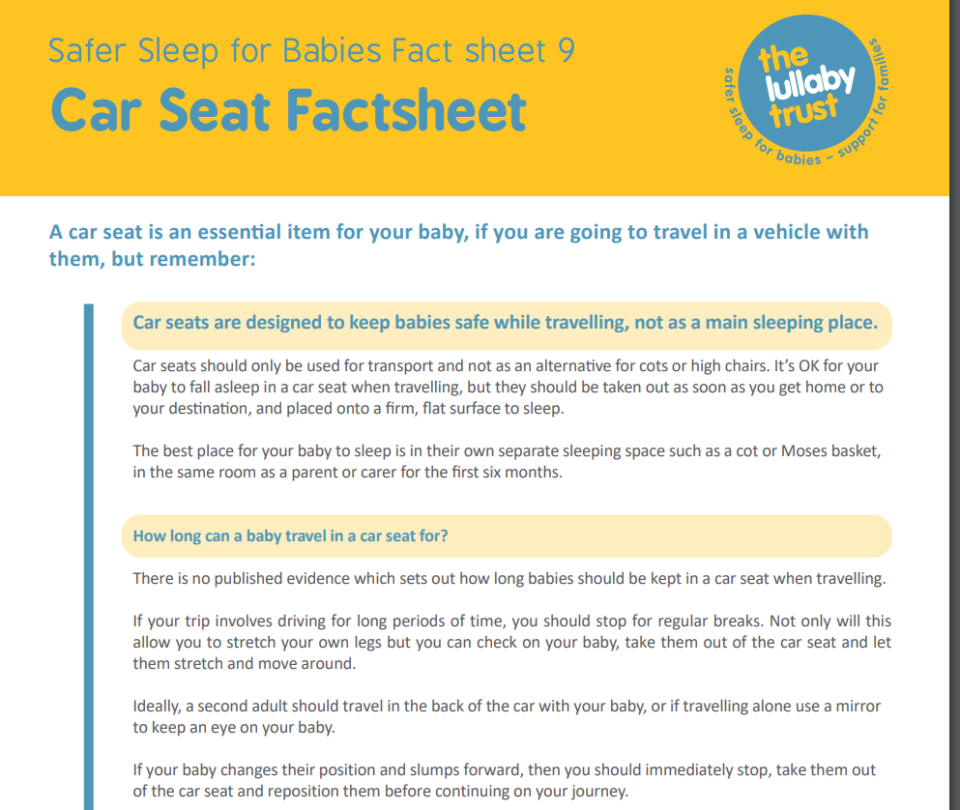
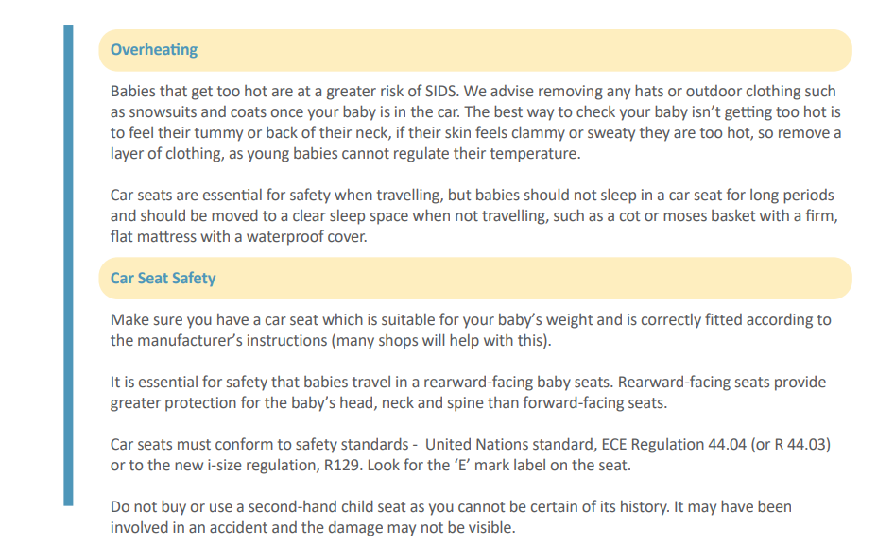
Car Seat Safety https://www.lullabytrust.org.uk/wp-content/uploads/car-seat-factsheet-2023.pdf

Slide 16
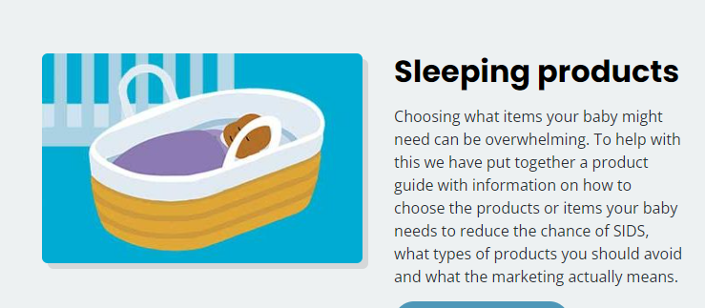
Baby product information
Sleepy heads
Slings
Positioners
Pillows
Bumpers
Notes:
There is a whole section in the baby hub where parents and you can learn all about baby product sleep safety.

Slide 17
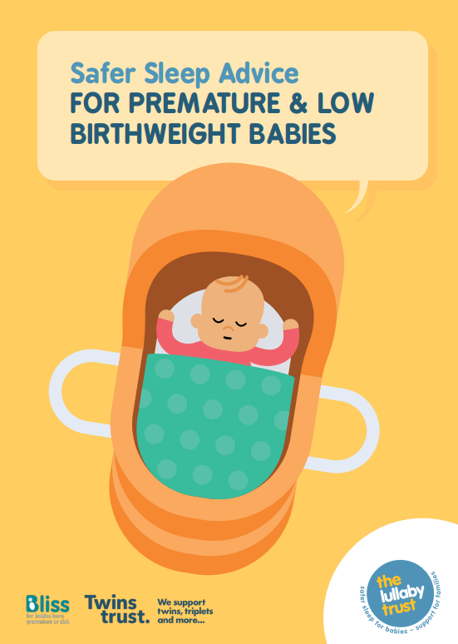
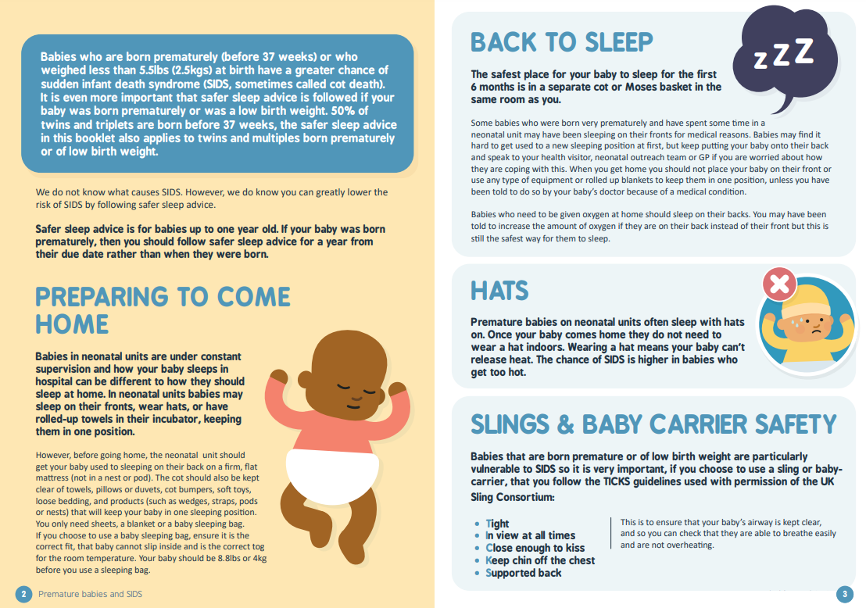
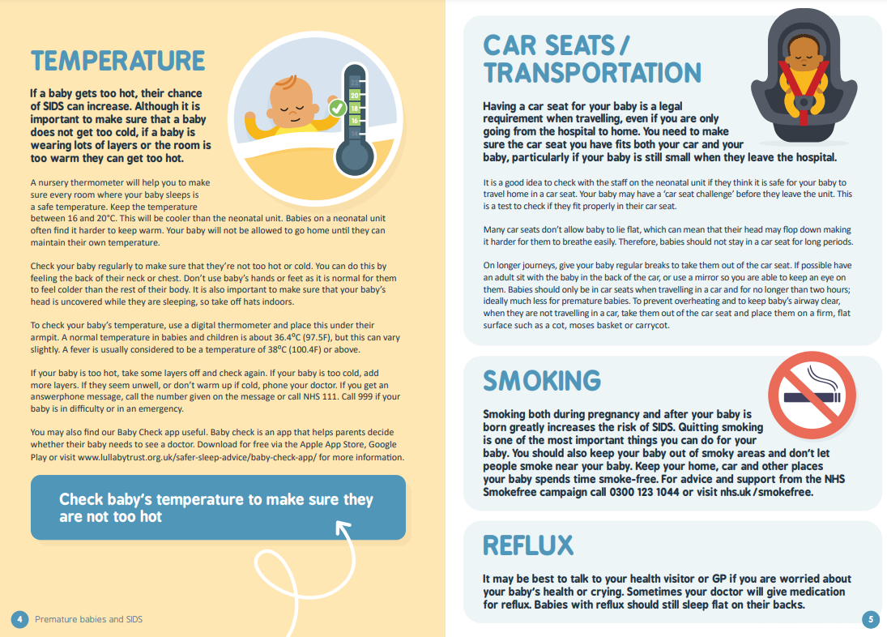
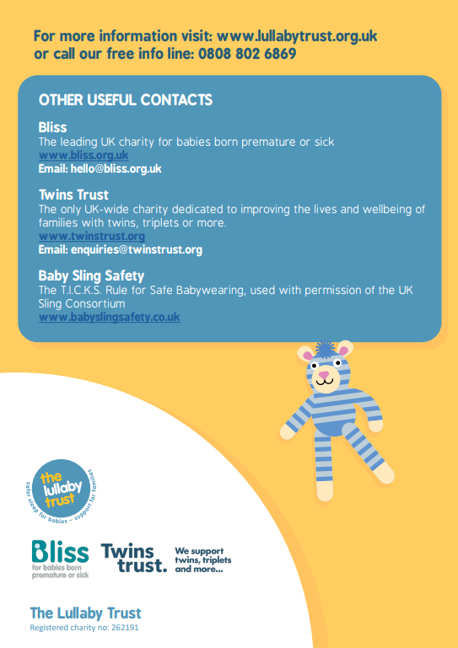
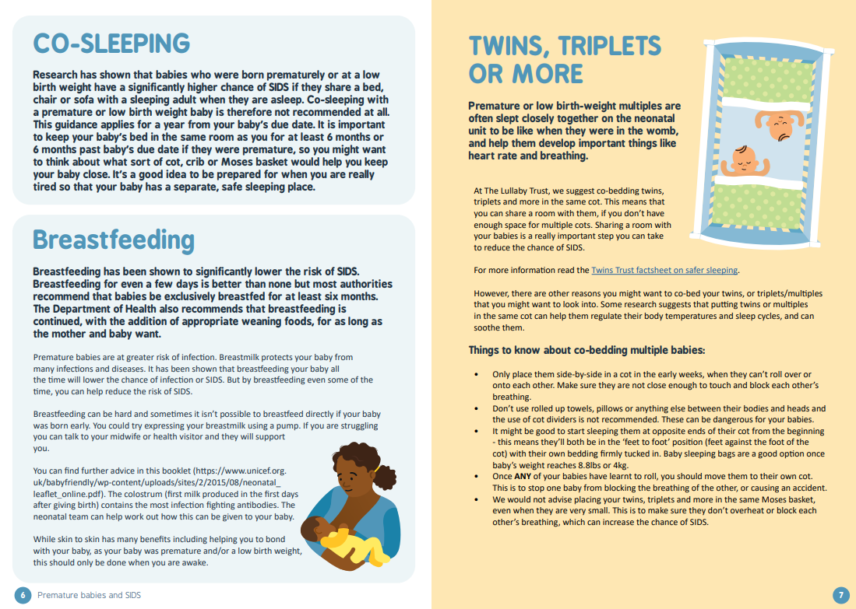
https://www.lullabytrust.org.uk/wp-content/uploads/The-Lullaby-Trust-Safer-Sleep-Advice-For-Premature-Babies.pdf
Notes:
An example of the information provided – this is all about premature and low birthweight babies who are much more at risk of SIDS.

Slide 18
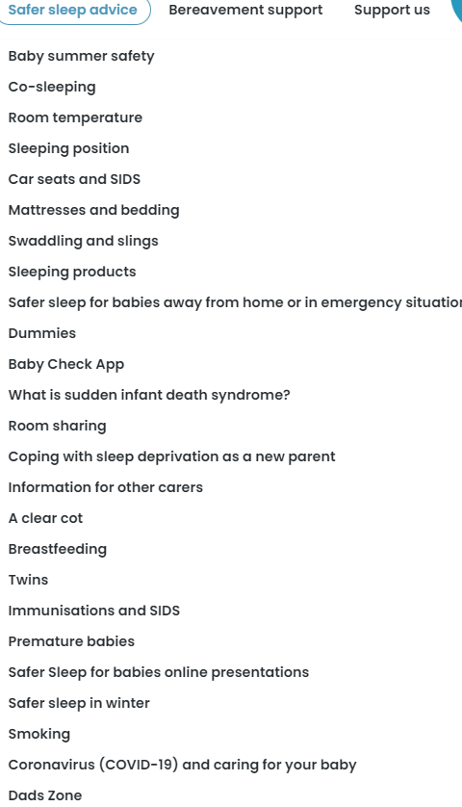

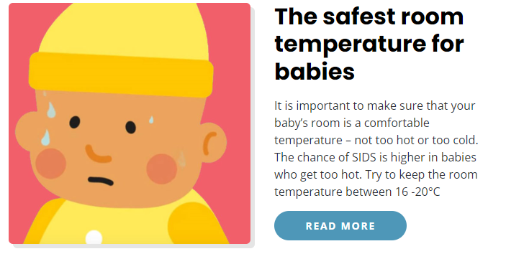


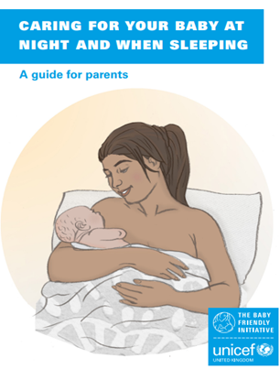

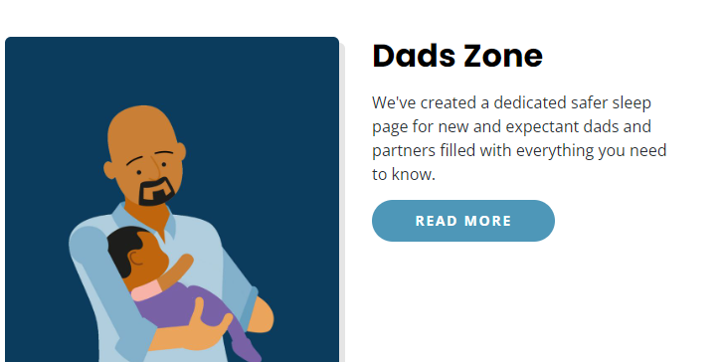
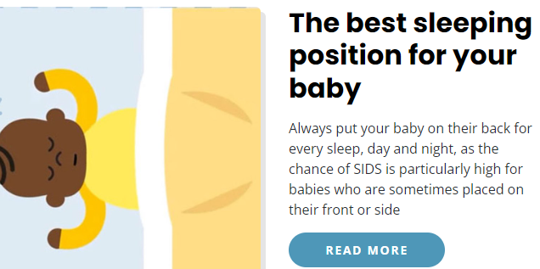
Resources
Health for Under 5s | For healthy, happy early years
Home | The Lullaby Trust
https://www.basisonline.org.uk/infant-sleep-info-app/
Notes:
Risk assessment tools are already available to look at – BASIS bed sharing quiz
Lullaby Trust Baby Check app to risk assess health of baby / unwell baby
Both have advice to follow.
https://www.basisonline.org.uk/co-sleeping-and-sids/
New BASIS app to support knowledge – includes ‘Bed Sharing Quiz’
https://www.basisonline.org.uk/infant-sleep-info-app/

Slide 19


Slide 20
Signposting and links
Home | The Lullaby Trust
Safer Sleep For Babies video
How to co-sleep more safely – YouTube video
Baby’s airway | The Lullaby Trust video
ABC poster_A4_digital
Lullaby Trust Safer Sleep Position
Professionals-guide.pdf
Video resources | The Lullaby Trust videos
Baby safety | The Lullaby Trust Baby Safety Hub
Antentatal conversations UNICEF
Safer-sleep-from-day-one.pdf (lullabytrust.org.uk)
Safer-sleep-for-babies-a-guide-for-parents-web.pdf (lullabytrust.org.uk)
Conversations in pregnancy - Antenatal signature sheet (unicef.org.uk)
Conversations in the postnatal period - Postnatal signature sheet (unicef.org.uk)

