Slide 1
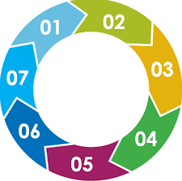
Harmful Sexual Behaviours– 7 Minute Briefing
Harmful Sexual Behaviours (HSB)
To be used at Team Meetings – 7 MINUTE BRIEFING
DID YOU KNOW harmful sexual behaviour is developmentally inappropriate sexual behaviour, which is displayed by children and young people, which may be harmful or abusive. It may be referred to as HSB or sexualised behaviour (Hackett 2014)
Technology Assisted HSB is sexualised behaviour which children or young people engage in using the internet or technology such as mobile phones. This includes viewing pornography or sexting alongside other forms of social media (Hollis/Belton 2017)
THE ARC Service has an HSB team based in Welwyn Garden City who specialise in direct work, assessments and consultations for young people and families including young people in care who display HSB. Staff are trained in the ARC model alongside specialised training in HSB.
A referral can be made from the case holder in Children’s Services
Here are some of the facts
Many YP who display HSB have additional learning needs or diagnosis such as ASD/ADHD (DMS Research, July 2019)
Many YP who display HSB have experienced trauma growing up e.g. abuse/neglect (NSPCC)
Most YP do not persist with these behaviours into adulthood (NSPCC)
There is a lot of support externally around HSB
NSPCC website
Lucy Faithful – Parents Protect
Barnardo’s
What to do
Hackett (2010) proposed a continuum for understanding the range of sexual behaviours displayed by young people from normal to violent
DID YOU KNOW
Hertfordshire are launching a new pathway and guidance soon (June 2021) to support professionals in social care, health and education to recognise and respond appropriately and consistently to concerns around HSB/sexualised behaviour STRATEGY & PATHWAY

